Slide 1
Living By Chemistry SECOND EDITION
Unit 5: FIRE
Energy, Thermodynamics, and Oxidation-Reduction

Slide 2
Lesson 99: Where’s the Heat?
Heat and Phase Change

Slide 3
ChemCatalyst
Imagine that you have a sample of 100 g of water at 85 °C. You place 100 g of ice at 0 °C into the water.
Predict the final temperature from the choices given. Explain your choice.
Describe how you might measure the amount of heat needed to melt the ice.
A. 80°C B. 60°C C. 42.5°C
D. 20°C E. 5°C

Slide 4
Key Question
What happens to the energy that is transferred during a phase change?

Slide 5
You will be able to:
define latent heat
describe the energy exchanges that take place during a phase change
explain the heating curve of water

Slide 6
Prepare for the Lab
Work in groups of four.

Slide 7
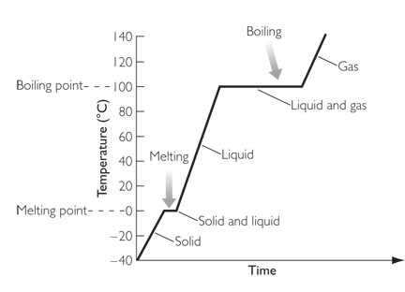
Discussion Notes
The graph showing changes in temperature as you heat water from solid to liquid to gas is called the heating curve of water.
During a phase change, the heat transferred to or from a substance does not result in a change in temperature.

Slide 8
Discussion Notes (cont.)
When a substance changes phase during heating, energy must be supplied to overcome the attractions between molecules.
Heat involved in phase changes can be exothermic or endothermic depending on the phase change.

Slide 9
Wrap Up
What happens to the energy that is transferred during a phase change?
The heating curve of water beginning with ice and ending with boiling water shows a sloped line, a plateau, another sloped line, and another plateau.
The two plateaus on the heating curve show that the temperature remains constant as ice melts and as water boils.

Slide 10
Wrap Up (cont.)
Heat that is required to change a substance from a liquid to a gas is called the heat of vaporization. Heat required to change a substance from a solid to a liquid is called the heat of fusion.

Slide 11
Check-In
If you boil water on a stove, the temperature of the water will remain close to 100 °C. As long as some liquid water remains in the pot, the temperature of the water will stay the same regardless of the outside temperature.
Explain why this is true.

