Slide 1
Living By Chemistry SECOND EDITION
Unit 4: TOXINS
Stoichiometry, Solution Chemistry, and Acids and Bases

Slide 2
Lesson 93: Get the Lead Out
Limiting Reactant and Percent Yield

Slide 3
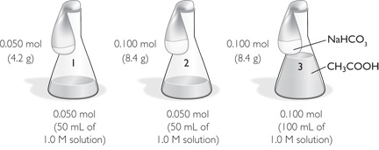
ChemCatalyst
Sodium bicarbonate, NaHCO₃, and acetic acid, CH₃COOH, react to generate CO₂ gas:
CH₃COOH(aq) + NaHCO₃(s) ➔ NaCH₃COO(aq) + H₂O(l) + CO₂(g)
You set up the reactions as shown. The gas generated by the reaction will inflate the balloon when the sodium bicarbonate is poured into the acetic acid.
Predict the relative order of the balloon sizes. Justify your choice.
a. 1 = 2 = 3 b. 1 < 2 < 3 c. 1 < 2 = 3 d. 1 = 2 < 3

Slide 4
Key Question
Which reactant determines how much product is made?

Slide 5
You will be able to:
complete stoichiometric calculations involving limiting reactant
calculate percent yield when the actual yield is known

Slide 6
Prepare for the Activity
Work in pairs.

Slide 7
Discussion Notes
In the real world, substances are rarely mixed in the exact mole ratios specified by a chemical equation.
In order to identify the limiting reactant, the number of moles of the reactants on hand must be compared with the mole ratio of the reactants.

Slide 8
Wrap Up
Which reactant determines how much product is made?
The limiting reactant is the substance that gets used up in a chemical reaction.
To determine the limiting reactant, calculate how many moles of each reactant you have. Consult the mole ratio to see which reactant will get used up.

Slide 9
Check-In
Consider this reaction:
N₂(g) + 3H₂(g) ➔ 2NH₃(g)
If you mix 28.0 g of nitrogen gas, N₂, and 12.0 g of hydrogen gas, H₂, which reactant is the limiting reactant? Show your work.
How much ammonia can be made from these amounts of reactants?

