Slide 1
Living By Chemistry SECOND EDITION
Unit 4: TOXINS
Stoichiometry, Solution Chemistry, and Acids and Bases

Slide 2
Lesson 89: Drip Drop
Titration

Slide 3
ChemCatalyst
A student mixes 100 mL of 0.10 M HCl with different volumes of 0.10 M NaOH.
1: 100 mL of 0.10 M HCl + 50 mL of 0.10 M NaOH
2: 100 mL of 0.10 M HCl + 100 mL of 0.10 M NaOH
3: 100 mL of 0.10 M HCl + 150 mL of 0.10 M NaOH
a. Which solution is the least toxic?
b. Are the final solutions acid, basic, or neutral?

Slide 4
Key Question
How can a neutralization reaction help you figure out acid or base concentration?

Slide 5
You will be able to:
explain and complete a titration procedure
use titration data to determine the molarity of a solution whose concentration is unknown

Slide 6
Prepare for the Lab
Work in pairs.
Wear safety goggles at all times.
Acids and bases are corrosive. Do not get any on skin or near eyes.
In case of a spill, rinse with large amounts of water.

Slide 7
Discussion Notes
The chemical equation for the neutralization reaction shows the ratio in which the substances combine.
HCl(aq) + NaOH(aq) ➔ NaCl(aq) + H₂O(l)

Slide 8
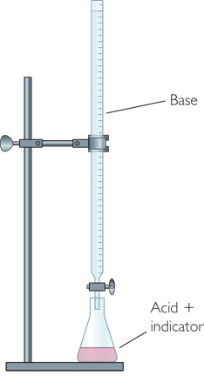
Discussion Notes (cont.)
A titration is a procedure in which a neutralization reaction is monitored with an indicator allowing you to calculate the unknown concentration of an acid or base.
When the equivalence point is reached in a titration between a strong acid and a strong base, the number of moles of H⁺ ions equals the number of moles of OH– ions.

Slide 9
Wrap Up
How can a neutralization reaction help you figure out acid or base concentration?
A titration is a procedure that allows you to calculate the unknown concentration of an acid or a base using a neutralization reaction.
During a titration, an indicator is used to signal when the equivalence point has been reached.

Slide 10
Check-In
A beaker has 50 drops of HCl, along with a drop of phenolphthalein indicator.
After 100 drops of 0.10 M NaOH are added, the color changes from clear to bright pink. What is the concentration of the original HCl solution?

