Slide 1
Living By Chemistry SECOND EDITION
Unit 4: TOXINS
Stoichiometry, Solution Chemistry, and Acids and Bases

Slide 2
Lesson 82: Holey Moley
Preparing Solutions

Slide 3
ChemCatalyst
Imagine that you want to make 5 L of 0.60 M NaCl solution for a saltwater aquarium. You need to determine the correct mass of NaCl needed to obtain the correct concentration, or the fish will die.
What information do you have?
What information do you need?

Slide 4
Key Question
How can you make a solution with a specific molarity?

Slide 5
You will be able to:
calculate the amounts necessary to create a solution with a desired volume and molarity
determine the number of grams of solute in a sample with a specific volume and molarity

Slide 6
Prepare for the Lab
Work in groups of four.

Slide 7
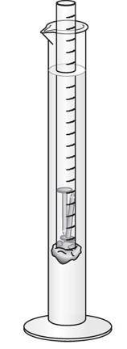
Discussion Notes
You can use a hydrometer to measure the density of a solution.
The 0.60 M solution comes closest to resembling ocean water.
There are several possible sources of error in this experiment.

Slide 8
Discussion Notes (cont.)
Molarity relates moles and liters.
Molarity = moles/liters
If you know the molarity of a solution and the size of the sample, you can calculate the number of grams of substance dissolved in that solution.
Grams = moles • molar mass

Slide 9
Wrap Up
How can you make a solution with a specific molarity?
In order to calculate the amount of solute needed to make a solution with a certain molarity, you must use the molar mass of the solute to convert moles to mass.
Solutions of specific concentrations can be made by weighing out the appropriate amount of the substance dissolved in the solution.
If you know the molarity and volume of a sample of solution, you can figure out the mass of the dissolved substance in that sample.

Slide 10
Check-In
How many grams of salt are in 0.100 L of 2.50 M NaCl?

