Slide 1
Living By Chemistry SECOND EDITION
Unit 1: ALCHEMY
Matter, Atomic Structure, and Bonding

Slide 2
Lesson 8: What Goes Around Comes Around
Conservation of Matter

Slide 3
ChemCatalyst
What do you think happened to the copper powder in the copper cycle experiment when it was mixed with the nitric acid?

Slide 4
Key Question
What happens to elements in a chemical change?

Slide 5
You will be able to:
explain that the product of chemical reactions depends on what was present at the time of reaction
explain that matter cannot be created or destroyed in a chemical reaction

Slide 6
Prepare for the Activity
Work in groups of four.

Slide 7
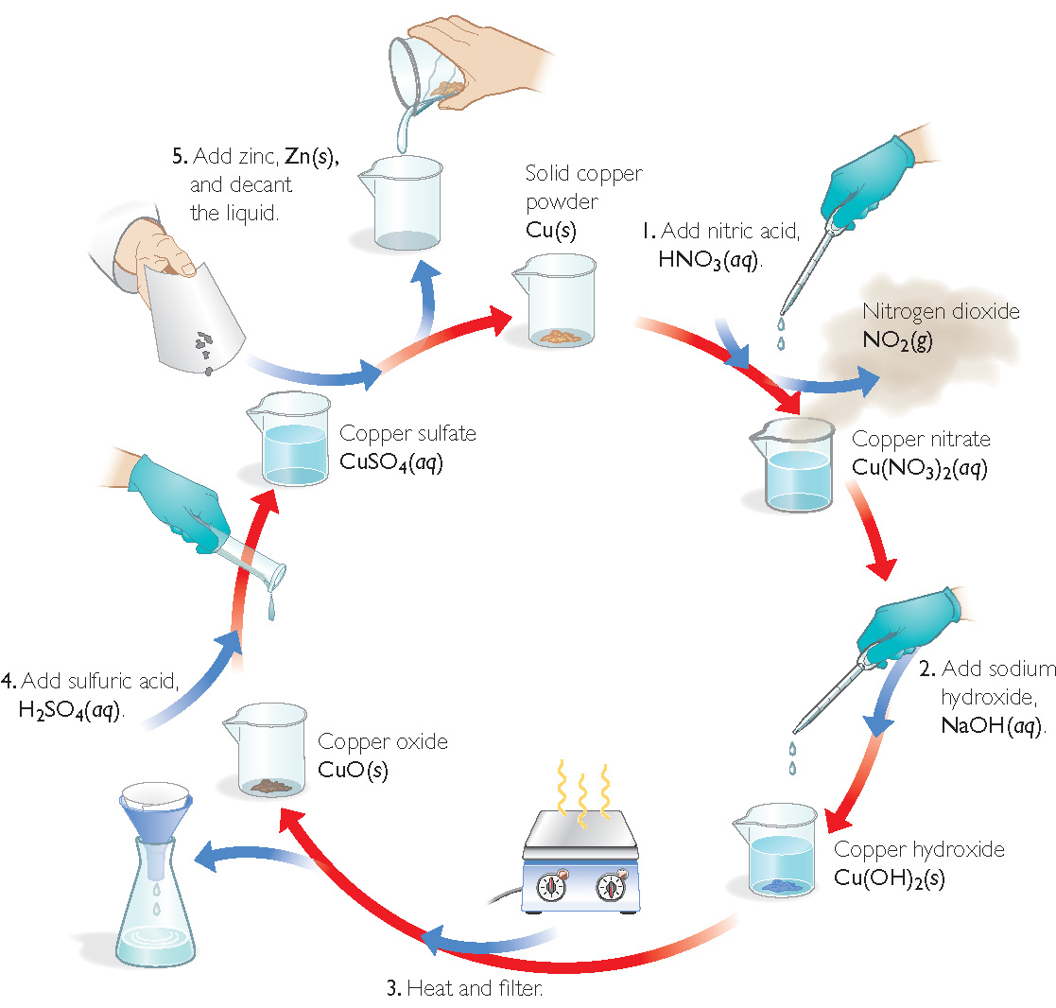
Discussion Notes
The Copper Cycle

Slide 8
Discussion Notes (cont.)
You could prove that copper was not destroyed by measuring the mass of the copper powder at the beginning and at the end of the experiment.
Law of conservation of mass: The law states that mass cannot be gained or lost in a chemical reaction–matter cannot be created or destroyed.

Slide 9
Discussion Notes (cont.)
No matter what was done to the copper, it was not broken down any further.
The observations we have made in the copper cycle lab provide further evidence that the golden penny is not gold.

Slide 10
Wrap Up
What happens to elements in a chemical change?
Elemental copper can be transformed through chemical reactions and then recovered.
We can represent elements with symbols and keep track of them during chemical reactions.
Elements combine and recombine but are not created or destroyed in chemical reactions.

Slide 11
Check-In
Sodium chloride, NaCl (aq), is added to silver nitrate, AgNO₃ (aq), resulting in NaNO₃ (aq) and a white solid.
Identify the white solid from the list below. Explain your choice.
AgCl (s) B. AgCl (aq)
C. AgNO₃(s) D. NaCl (s)

