Slide 1
Living By Chemistry SECOND EDITION
Unit 4: TOXINS
Stoichiometry, Solution Chemistry, and Acids and Bases

Slide 2
Lesson 72: Atom Inventory
Balancing Chemical Equations

Slide 3
ChemCatalyst
Does this equation obey the law of conservation of mass? Why or why not?
CuCl₂(aq) + Na₂S(aq) ➔ CuS(s) + NaCl(aq)

Slide 4
Key Question
How do you balance atoms in a chemical equation?

Slide 5
You will be able to:
balance a simple chemical equation
explain the role of coefficients in chemical equations

Slide 6
Prepare for the Activity
Work in pairs.

Slide 7
Discussion Notes
How did you figure out how many multiples of each substance to include in the equations?
A balanced chemical equation is one that shows the true mathematical relationship between the reactants and the products in a chemical reaction.
Your final step should be to inventory atoms on each side
Use coefficients and subscripts to total atoms of each element

Slide 8
Discussion Notes (cont.)
Consider the following example:
CH₄(g) + O₂(g) ➔ CO₂(g) + H₂O(g)
Inventory of Atoms
Reactants | Products
1 C | 1 C
4 H | 2 H
2 O | 3 O
Unbalanced!

Slide 9
Discussion Notes (cont.)
CH₄(g) + O₂(g) ➔ CO₂(g) + 2H₂O(g)
Inventory of Atoms
Reactants | Products
1 C | 1 C
4 H | 4 H
2 O | 4 O

Slide 10
Discussion Notes (cont.)
CH₄(g) + 2O₂(g) ➔ CO₂(g) + 2H₂O(g)
Inventory of Atoms
Reactants | Products
1 C | 1 C
4 H | 4 H
4 O | 4 O

Slide 11
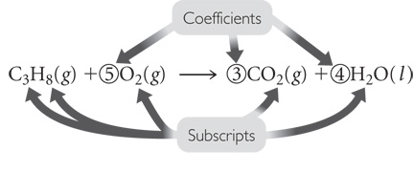
Consider the following…
In the equation shown, how many oxygen molecules react with one propane molecule?
How many molecules of carbon dioxide will be produced if 1,000 molecules of propane react with 5,000 molecules of oxygen?
Can you substitute the number of moles for the coefficients in a chemical equation? Explain how.

Slide 12
Discussion Notes (cont.)
There are two types of numbers in a chemical equation: coefficients and subscripts.
Coefficients: The coefficients in a chemical equation are the numbers in front of the chemical formulas of the reactants and products. They show the correct ratio in which the reactants combine to form the products.
The coefficients in a chemical equation indicate how many “units” of an element or a compound you have.

Slide 13
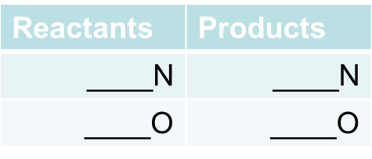
Work through the following examples:
NO (g) + O₂ (g) → NO₂ (g)
2. Fe (s) + O₂ (g) → Fe₂O₃ (s)
Reactants | Products
____Fe | ____Fe
____O | ____O

Slide 14
Wrap Up
How do you balance atoms in a chemical equation?
In order for matter to be conserved, the number of atoms on both sides of a chemical equation must be equal.
When a chemical equation is balanced, it indicates how many molecules or moles of each substance take part in a reaction and how many molecules or moles of the product(s) are produced.

Slide 15
Check-In
Balance this equation:
Ca(s) + O₂(g) ➔ CaO(s)

