Slide 1
Lesson 67: Hurricane!
Extreme Physical Change

Slide 2
ChemCatalyst
What is a hurricane? What characteristics does it have?
Where do hurricanes form?

Slide 3
Key Question
What are hurricanes and what causes them?

Slide 4
You will be able to:
describe the meteorological conditions that result in a hurricane
explain the role of phase change, air pressure, and temperature in hurricane formation
define climate and global warming

Slide 5
Prepare for the Activity
Work individually.

Slide 6
Discussion Notes
Hurricanes are destructive storms characterized by strong winds and large amounts of rainfall.
Tropical depressions can build to tropical storms, which can build to hurricanes.
There are five categories of hurricane, with category 1 the least intense and category 5 the most intense.

Slide 7
Discussion Notes (cont.)
Tropical storms begin forming when a great deal of warm water evaporates into the atmosphere.
As the storm moves over areas of warmer water, evaporation increases.
Water vapor density is related to temperature.

Slide 8
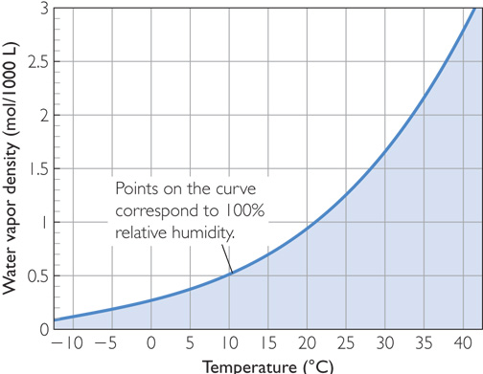
Discussion Notes (cont.)
Water Vapor Density Versus Temperature

Slide 9
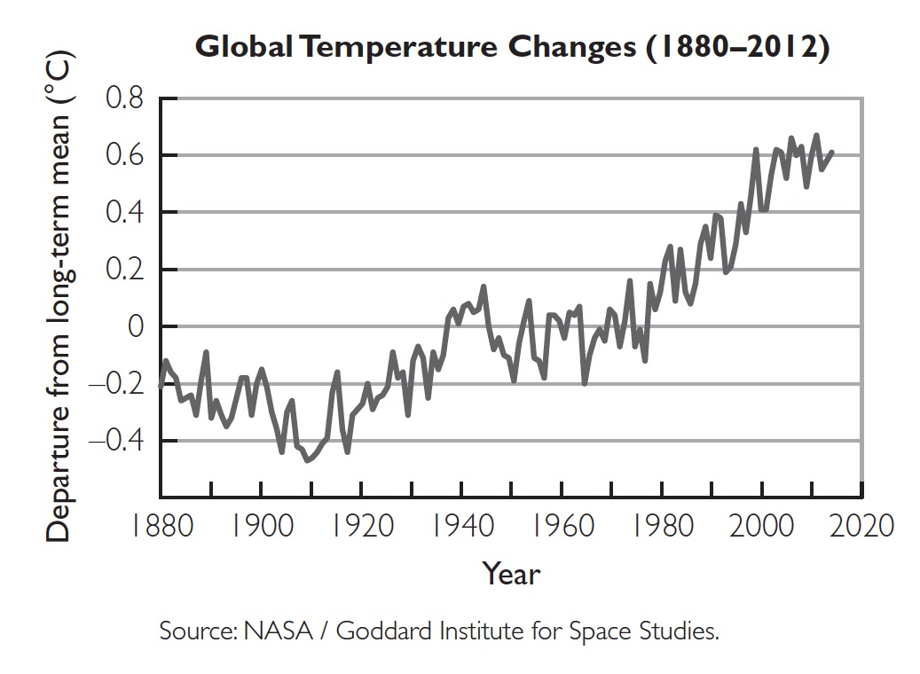
Discussion Notes (cont.)

Slide 10
Discussion Notes (cont.)
There is a great deal of scientific evidence supporting the idea that our planet is in a warming cycle, often referred to as global warming.
Global warming is causing climate change.

Slide 11
Wrap Up
What are hurricanes and what causes them?
Hurricanes are intense tropical weather systems accompanied by strong winds, massive amounts of rain, and ocean flooding. They form around low-pressure systems and are characterized by spiraling clouds and winds.
Hurricanes form over the ocean in places where there is extremely warm, moist air.

Slide 12
Wrap Up (cont.)
Rapid evaporation and subsequent condensation of moisture set up an air pressure differential that further feeds the evaporation and condensation.
At higher temperatures, small changes in temperature have dramatic effects on water vapor density, n/V. Global warming may increase the frequency and intensity of hurricanes on the planet.

Slide 13
Check-In
Why do most hurricanes have their origins near the equator?

