Slide 1
Lesson 66: Feeling Humid
Humidity, Condensation

Slide 2
ChemCatalyst
Is there water vapor in the air right now? What evidence do you have to support your answer?
What do you think humidity means? How does humidity depend on temperature?

Slide 3
Key Question
What is humidity and how is it measured?

Slide 4
You will be able to:
define humidity and relative humidity
explain the relationship between humidity and phenomena such as cloud formation, fog, rainfall, and dew
explain the relationship between water vapor density and air temperature

Slide 5
Prepare for the Lab
Work in groups of four.
Humidity: The density of the water vapor in the air at any given time. Humidity is dependent on air temperature and pressure.

Slide 6
Discussion Notes
Humidity is a measure of the amount of water vapor in the air.
The condensation procedure provides evidence that water vapor is present in the air.
The temperature at which water vapor condenses indicates how much water vapor is in the air.

Slide 7
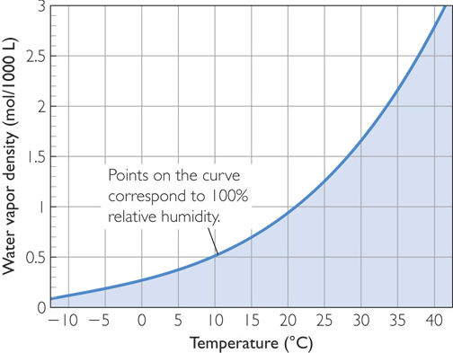
Discussion Notes (cont.)
Water Vapor Density Versus Temperature

Slide 8
Discussion Notes (cont.)
There is an upper limit to the amount of water vapor that can be present in the atmosphere at a given temperature.
Humidity is sometimes expressed as relative humidity.
Relative humidity: The amount of water vapor in the air compared to the maximum amount of water vapor possible for a specific temperature, expressed as a percent.

Slide 9
Wrap Up
What is humidity and how is it measured?
Humidity is a measure of the amount of water vapor in the air. It can be expressed as water vapor density or as relative humidity.
Water vapor density is affected by both air temperature and air pressure.
There is a limit to the amount of water vapor that can be present in the air at a given temperature. The maximum amount possible is called 100% relative humidity.

Slide 10
Check-In
On a hot summer day, a firefighter records a dry-bulb temperature of 30°C and a wet-bulb temperature of 12 °C. What does this tell you about the relative humidity?

