Slide 1
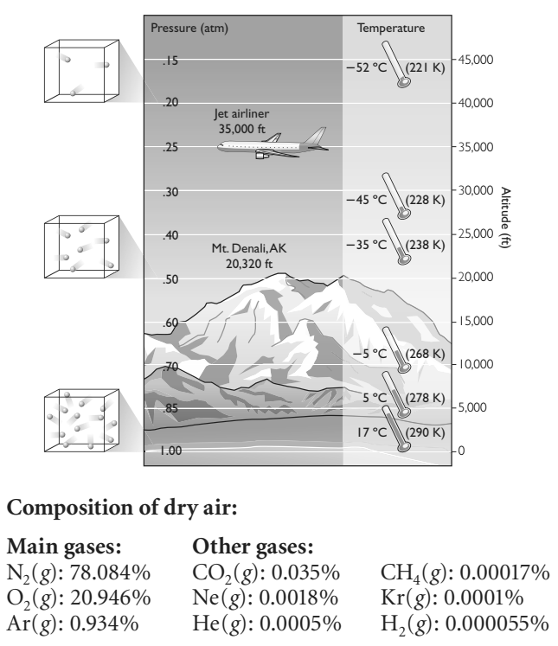
Lesson 64: STP - The Mole and Avogadro’s Law
Consider number density from yesterday as it relates to our atmosphere at high altitudes…
~ How does this affect human physiology?
~ What is the “Death Zone” or “Vertical Limit” of the big Mountains (K2, Everest, Denali)?

Slide 2
ChemCatalyst – Answer on your card
There are two balloons. One is filled with helium, He, and the other with carbon dioxide, CO₂.
Describe what happens when the balloons are released.
For the two balloons, state whether these properties are the same or different, and explain why:
• pressure, P | • number density, n/V
• temperature, T | • number, n
• volume, V | • density, m/V
• mass, m

Slide 3
Key Question
How do chemists keep track of the number of gas particles?

Slide 4
You will be able to:
define a mole
explain Avogadro’s law
define standard temperature and pressure

Slide 5
Prepare for the Activity ~ Individual
Chemists use a unit called a mole to describe the number of gas particles in a sample.
1 mole = 602,000,000,000,000,000,000,000
(602 sextillion particles)
2 moles = ?
0.5 moles = ?

Slide 6
Discussion Notes
Standard temperature and pressure, STP: One atmosphere of pressure (1.0 atm) and a temperature of 273 K (0ºC).
Under these conditions: ANY gas with the same volume will have equal numbers of gas particles (because the temperature and pressure are the same).
This is Avagadro’s Law

Slide 7
Discussion Notes (cont.)
Specifically, there are exactly 602,000,000,000,000,000,000,000 particles in 22.4 L OF ANY GAS at STP.
Remember:
Mole: A unit invented by chemists to count large numbers of gas particles. There are 602,000,000,000,000,000,000,000 particles in 1 mole. This is 602 sextillion.

Slide 8
Wrap Up
How do chemists keep track of the number of gas particles?
Avogadro’s law states that equal volumes of gases contain the same number of particles if they are at the same temperature and pressure. This holds true for all gases.
Gases are often compared at a standard temperature and pressure of 1 atm and 273 K. This is also referred to as STP.
At STP, any gas will occupy 22.4 L and consist of exactly 602 sextillion, or 602,000,000,000,000,000,000,000, particles.

Slide 9
Check-In: Answer on your Card
One balloon contains 22.4 L of Ar, argon gas, and another balloon contains 22.4 L of Ne, neon gas. Both balloons are at 273 K and 1 atm.
Do the balloons contain the same number of atoms? Why or why not?
Will the balloons have the same mass? Why or why not?

