Slide 1
Living By Chemistry
Unit 3: WEATHER
Phase Changes and Behavior of Gases

Slide 2
Lesson 63: n is for Number
Pressure and Number Density

Slide 3
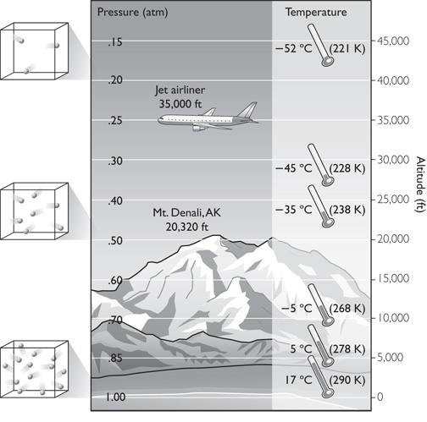
ChemCatalyst
Earth’s Atmosphere
Compare the atmosphere at sea level and at 34,000 ft, the altitude at which airplanes fly.
Describe at least three differences.
Explain why it is difficult to breathe at 34,000 ft.

Slide 4
Key Question
How is the number of gas molecules in a sample related to pressure?

Slide 5
You will be able to:
define the number density of a gas
describe the number density of the atmosphere as it relates to altitude
explain the relationship between number density and gas pressure
describe one way to measure gas pressure

Slide 6
Prepare for the Lab
Work in groups of four.
Wear safety goggles at all times during the lab.

Slide 7
Discussion Notes
The gas pressure increases as the number of gas molecules per unit of volume increases.
P = k( )
Number density: The number of gas particles per unit volume. Number density = n/V
The height of the water levels in a U-tube indicates differences in pressure.
n V

Slide 8
Discussion Notes (cont.)
In order to make the water levels uneven, it is necessary to seal off one end with a finger, a syringe, a cork, or a balloon.

Slide 9
Discussion Notes (cont.)
Air pressure can be determined by measuring the difference in height of a liquid.

Slide 10
Wrap Up
How is the number of gas molecules in a sample related to pressure?
The composition of Earth’s atmosphere is not uniform. The density of the gas molecules in the air decreases with increasing altitude. This causes the pressure of the atmosphere to decrease with increasing altitude.
The number density of a gas is the number of gas molecules per unit of volume, n/V.
The pressure of a gas is directly proportional to the number of gas molecules per unit of volume. This relationship is written as P = k·(n/V).

Slide 11
Check-In
A balloon is filled with helium, tied off, and then released. As it climbs into the air, its volume slowly increases.
Explain what is going on with the helium atoms inside the balloon and the air molecules outside the balloon in terms of number density and pressure.

