Slide 1
Living By Chemistry SECOND EDITION
Unit 3: WEATHER
Phase Changes and Behavior of Gases

Slide 2
Lesson 61: What Goes Up
Combined Gas Law

Slide 3
ChemCatalyst
A weather balloon is inflated with helium to a volume of 125,000 L. When it is released, it rises high into the atmosphere, where both the pressure and the temperature are lower.
Explain why the balloon rises.
Will the balloon pop at a high altitude? Explain your thinking.

Slide 4
Key Question
What is the relationship among pressure, volume, and temperature for a sample of gas?

Slide 5
You will be able to:
define the combined gas law
solve gas law problems that involve changes in all three of the variables, P, V, and T

Slide 6
Prepare for the Activity
You will be using P, T, V data for a weather balloon…
These instruments are filled with He or H2 gas and carry instruments to study the atmosphere at high altitudes
As the balloon rises, the instruments take measurements to relay back to the station via transmitter.
A weather balloon is a closed container
Remember: the atmosphere changes in pressure and temperature with altitude – how? How do you think a gas sample in the air will respond to these changes?

Slide 7
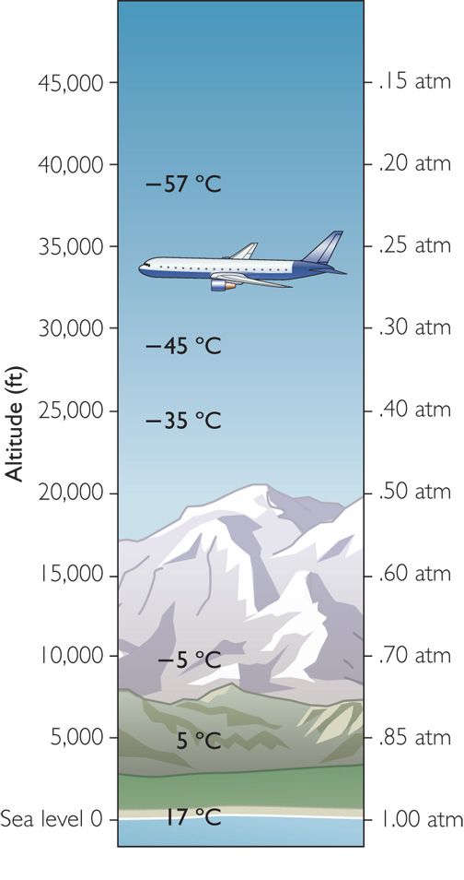
Altitude | Temperature (°C) | Temperature (K) | Pressure (atm) | Volume (L)
40,000 ft | –57°C | 216 K | 0.20 atm | 47,000 L
30,000 ft | –45°C | 228 K | 0.30 atm | 33,000 L
25,000 ft | –35°C | 238 K | 0.40 atm | 26,000 L
10,000 ft | –5°C | 268 K | 0.70 atm | 17,000 L
5,000 ft | 5°C | 278 K | 0.80 atm | 15,000 L
0 ft | 17°C | 290 K | 1.0 atm | 12,500 L

Slide 8
For your consideration…
The weather balloon rises no matter what the outside conditions because the balloon is full of helium, and helium is less dense than air.
Sample Problem:
A balloon has a volume of 12,000L at sea level where the pressure is 1.0atm and the temperature is 285K. The balloon is released and travels to an altitude of 5,000 feet where the temperature is 278K and the pressure is 0.80atm. What is the new volume of the balloon?

Slide 9
Discussion Notes
The relationship among the pressure, temperature, and volume of a gas is described by the combined gas law.
Combined Gas Law
P1V1
T1
P2V2
T2
K = PV
T
or
=
or
P1V1T2
=
P2V2T1

Slide 10
Wrap Up
What is the relationship among pressure, volume, and temperature for a sample of gas?
If volume, temperature, and pressure all vary, then you can use the combined gas law to determine the effects of changing two variables on the third. (Amount of gas remains the same.)
k =
Air temperature and air pressure both decrease with increases in altitude.
Ultimately, for a weather balloon, gas pressure has a greater effect on gas volume than does gas temperature.
PV T

Slide 11
Check-In
A sample of neon gas occupies a volume of 1.0 L at 300 K and 1.0 atm.
Suppose you increase the temperature to 600 K and decrease the pressure to 0.50 atm. What is the new volume of the gas?

