Slide 1
Living By Chemistry SECOND EDITION
Unit 3: WEATHER
Phase Changes and Behavior of Gases

Slide 2
Lesson 58: Feeling Under Pressure
Boyle’s Law

Slide 3
ChemCatalyst
An empty plastic water bottle has a cork fitted into the opening.
Predict what would happen if you stepped on the plastic bottle.
Explain your answer in terms of pressure and volume.

Slide 4
Key Question
How does gas volume affect gas pressure?

Slide 5
You will be able to:
explain the relationship between gas pressure and gas volume
define an inversely proportional relationship
state Boyle’s law

Slide 6
Prepare for the Lab
Work in pairs for the lab. Watch the demonstration as a class.
For your safety and the safety of others around you, point the capped end of the syringe down and away from eyes.

Slide 7
Discussion Notes
In the syringe and scale experiment, you put weight on the gas in the syringe, which you measured in pounds on the scale.
When the volume of a gas is decreased, its pressure goes up.

Slide 8
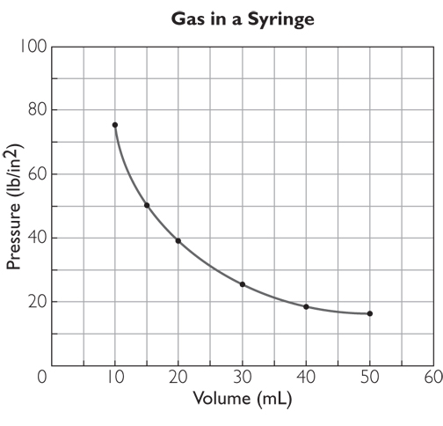
Discussion Notes (cont.)
The relationship between gas pressure and gas volume is called an inverse proportion.
Inverse proportion: Two variables are inversely proportional to each other if one variable increases when the other decreases.

Slide 9
Discussion Notes (cont.)
The curve on the graph is nearly vertical for small volumes and nearly horizontal for large volumes.
The mathematical relationship between pressure and volume is described by the equation
PV = k or P = k/V
A graph of P versus 1/V is a straight line going through the origin.

Slide 10
Discussion Notes (cont.)
Boyle’s law: The pressure of a given amount of gas is inversely proportional to its volume, if the temperature and amount of gas are not changed. The relationship between pressure and volume can be expressed as PV = k, or P = k(1/V), where k is the proportionality constant.
Boyle’s law enables you to solve problems involving gas pressure and gas volume.

Slide 11
Wrap Up
How does gas volume affect gas pressure?
Gas pressure is inversely related to its volume. When the volume of a gas decreases, its pressure increases, and vice versa.
The mathematical relationship between gas pressure and volume can be described by the formula PV = k or P = k/V, provided the temperature and amount of gas are kept the same. This relationship is known as Boyle’s law.

Slide 12
Check-In
A balloon full of gas occupies 7.5 L, and the pressure on the outside of the balloon is 1.0 atm.
What do you predict will happen to the pressure inside the balloon if the balloon is placed underwater to a depth at which its new volume is 2.5 L?

