Slide 1
Lesson 55: Front and Center
Density, Temperature, and Fronts

Slide 2
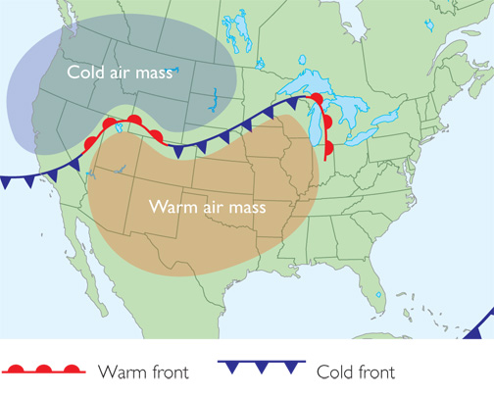
ChemCatalyst
Large air masses form over different regions of land and ocean. These air masses have a consistent temperature and moisture content.
What patterns do you notice in the temperatures and moisture content of the air masses shown on the map?
Why do you think clouds form when the Continental Polar air mass collides with the Maritime Tropical air mass?
Use the concept of density to explain why warm air in the Maritime Tropical air mass rises, while cold air in the Continental Polar air mass descends.

Slide 3
Key Question
How do weather fronts affect the weather?

Slide 4
You will be able to:
explain the roles of temperature and density in the movement of cold and warm air masses
describe the weather patterns associated with warm fronts and cold fronts

Slide 5
Prepare for the Activity
Work in groups of four.

Slide 6
Prepare for the Activity (cont.)
A cold front forms when a cold air mass catches up with a warm air mass, while a warm front forms when a warm air mass catches up with a cold air mass.

Slide 7
Discussion Notes
Fronts occur between the boundaries of warm and cold air masses.
Warm and cold air masses have different densities.

Slide 8
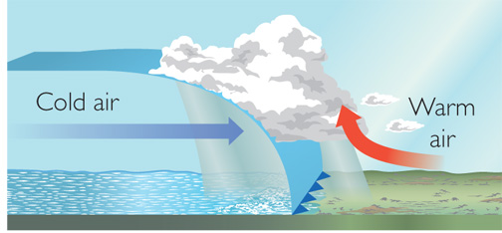
Discussion Notes (cont.)
In a cold front, cold air overtakes warm air.

Slide 9
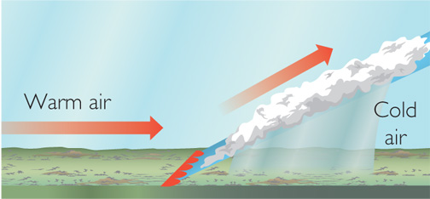
Discussion Notes (cont.)
In a warm front, warm air overtakes cold air.

Slide 10
Discussion Notes (cont.)
The weather associated with cold and warm fronts differs.
Interactions among the temperature, volume, and density of air masses contribute significantly to the formation of weather.

Slide 11
Wrap Up
How do weather fronts affect the weather?
Fronts form where air masses overtake each other.
Storms and precipitation occur at both warm fronts and cold fronts.
Density differences account for the movement and layering of air masses when they meet.
Temperature differences account for phase changes that occur when air masses meet, causing precipitation.

Slide 12
Check-In
A warm front is approaching your hometown. It is one day away.
What would you expect to observe in the way of weather?

