Slide 1
Living By Chemistry SECOND EDITION
Unit 3: WEATHER
Phase Changes and Behavior of Gases

Slide 2
Lesson 53: Absolute Zero
Kelvin Scale

Slide 3
ChemCatalyst
Researchers have recorded the temperature on Triton, a moon of Neptune, as –235 °C.
Do you think carbon dioxide, CO2, would be a solid, a liquid, or a gas at this temperature? Explain your reasoning.
What do you think is the coldest temperature something can get to? What limits how cold something can get?

Slide 4
Key Question
How cold can substances become?

Slide 5
You will be able to:
describe the relationship between the Celsius and Kelvin temperature scales
explain the concept of absolute zero
describe the motion of gas molecules according to the kinetic theory of gases

Slide 6
Prepare for the Computer Activity
Work individually.

Slide 7
Discussion Notes
On the Celsius scale, the temperature at which the volume of a gas is theoretically equal to 0 is °273 ｰC.
K = °C + 273
°C = K – 273

Slide 8
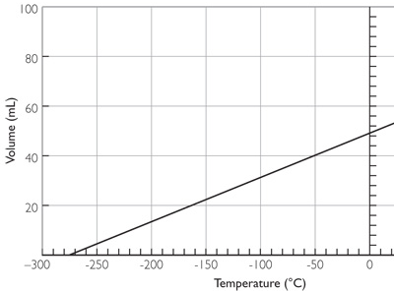
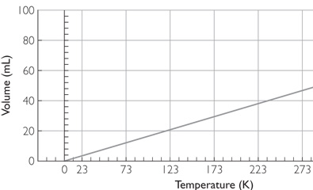
Discussion Notes (cont.)
A temperature of 0 K is referred to as absolute zero.
Celsius Scale Volume of Gas Versus Temperature
Volume of Gas Versus Kelvin Temperature

Slide 9
Discussion Notes (cont.)
The model displayed in the simulation is the kinetic theory of gases.
Gas particles are constantly moving
The motion of gas particles is random.
Gas particles move in straight lines.
The speeds of the particles are not all the same.
Gas particles have a lot of space to move around in. (They are tiny compared to the space they are found in.)
Gas particles change directions when they hit each other or the walls of the container.

Slide 10
Discussion Notes (cont.)
As the temperature increases, the average speed of the particles increases.
The temperature of a gas is a measure of the average energy of motion of the gas particles.

Slide 11
Wrap Up
How cold can substances become?
The Kelvin scale assigns a value of zero to the temperature of a gas with a hypothetical volume of zero.
Conversion between the Celsius scale and the Kelvin scale is given by the formula K = °C + 273.
Gas particles are in constant motion. The average speed of gas particles increases as the temperature increases.
The volume of a gas changes as the temperature changes, if the gas is in a flexible container.

Slide 12
Check-In
Describe three features of the motions of gas particles.
Use the motions of gas particles to explain why gases expand when they are heated.

