Slide 1
Living By Chemistry SECOND EDITION
Unit 3: WEATHER
Phase Changes and Behavior of Gases

Slide 2
Lesson 51: Having a Meltdown
Density of Liquids and Solids

Slide 3
ChemCatalyst
Water resource engineers measure the depth of the snowpack in the mountains during the winter months to predict the amount of water that will fill the lakes and reservoirs the following spring.
Do you think 3 inches of snow is the same as 3 inches of rain? Explain your reasoning.
How could you figure out the volume of water that will be produced by a particular depth of snow?

Slide 4
Key Question
How much water is present in equal volumes of snow and rain?

Slide 5
You will be able to:
make density calculations, converting volumes of liquids and solids
explain how phase changes affect the density of a substance
use density equations to calculate the volume of water in a sample of snow or ice

Slide 6
Prepare for the Lab
Work in groups of four.

Slide 7
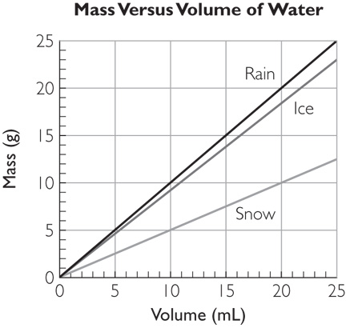
Discussion Notes

Slide 8
Discussion Notes (cont.)
You can determine the density of water by measuring the mass of a certain volume of water. The density, D, is the mass, m, divided by the volume, V:
D =
The densities of snow and ice are less than the density of water.
m
V

Slide 9
Discussion Notes (cont.)
The graph you created allows you to compare the densities of the different phases of water.
The relationship D = can also be written as m = DV.
m
V

Slide 10
Discussion Notes (cont.)
For any proportional relationship, the graph is a straight line that passes through the origin, (0, 0).
Scientists measure snowpack in terms of depth—meters or feet—and then make conversions to obtain the volume of water.

Slide 11
Wrap Up
How much water is present in equal volumes of snow and rain?
In density calculations, mass and volume are proportional to each other.
The formula D = can also be written m = DV.
When a substance changes phase (from solid to liquid to gas), its density changes. The mass stays the same, and the volume changes.
Water is denser than snow. Ice is less dense than water.
m
V

Slide 12
Check-In
Imagine that you have equal masses of snow and rain. Which has a greater volume? Explain your thinking.
What is the mass of 14 mL of rainwater?

