Slide 1
Living By Chemistry SECOND EDITION
Unit 3: WEATHER
Phase Changes and Behavior of Gases

Slide 2
Lesson 50: Raindrops Keep Falling
Measuring Liquids

Slide 3
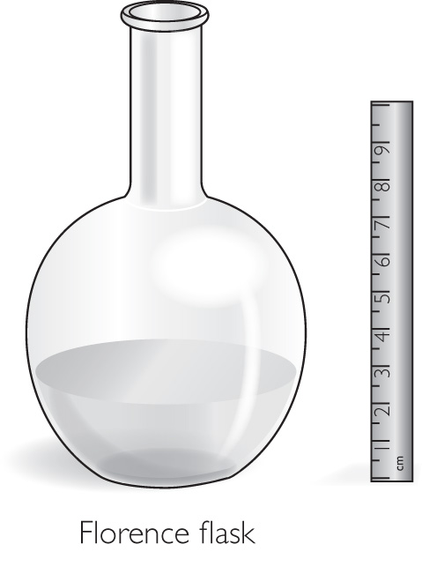
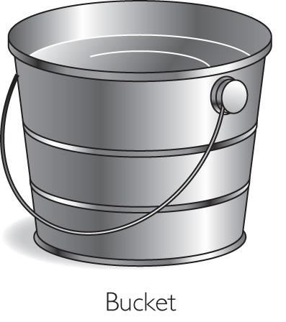
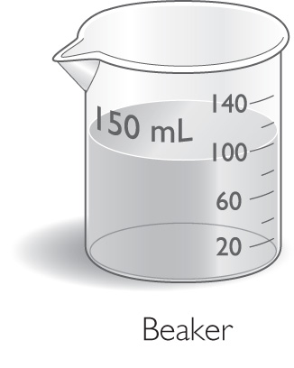
ChemCatalyst
How is rainfall usually measured? Describe the type of instrument you think is usually used.
Which of these containers would make the best rain gauge? Explain your reasoning.

Slide 4
Key Question
How do meteorologists keep track of the amount of rainfall?

Slide 5
You will be able to:
identify a proportional relationship
describe several methods for solving a problem involving proportional variables
explain why rainfall is measured in terms of height rather than volume

Slide 6
Prepare for the Lab
Work in pairs.

Slide 7
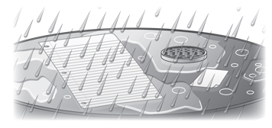
Prepare for the Lab (cont.)
Does the same amount of rain fall on each area? How could you measure the amount of rain that falls on the objects?

Slide 8
Discussion Notes
The data points show that volume increases in a steady and predictable way in relation to the height of the beaker.
Proportional: Two variables are directly proportional when you can multiply the value of one by a constant to obtain the value of the other.

Slide 9
Discussion Notes (cont.)
The graphed line and the math associated with the line represent an ideal.
The volume of rainfall increases regularly in relation to the height of the rainfall.
The height of rain collected in a rain gauge does not depend on the diameter of the container.
The volume of rain collected does depend on the diameter of the container.

Slide 10
Discussion Notes (cont.)
If meteorologists reported rainfall in terms of volume, they would all need to use a rain gauge with the exact same size and shape in order to be able to compare measurements.

Slide 11
Discussion Notes (cont.)
There are countless examples of proportional relationships in the world around you. For example:
The number of steps in a staircase is proportional to the total height of the staircase.
The number of pages in a book is proportional to the thickness of the book.
The relationship between centimeters and inches is proportional.

Slide 12
Discussion Notes (cont.)
All these proportional relationships can be expressed mathematically.
In each case, one number in the equation does not change.
Proportionality constant: The number that relates two variables that are proportional to each other. It is represented by a lowercase k.

Slide 13
Wrap Up
How do meteorologists keep track of the amount of rainfall?
Meteorologists measure the height of rain, because the volume of rain is directly proportional to the height of the water measured.
Graphs of two variables that are proportional are always a straight line through the origin.
When one variable is proportional to another, it is possible to make accurate predictions of other values when one data point is known.

Slide 14
Check-In
Suppose you find that a cylindrical rain gauge contains a volume of 8 mL of rain for a height of 2 cm of rain.
Describe how you might figure out the volume of rain for a height of 10 cm of rain in this same container.

