Slide 1
Living By Chemistry SECOND EDITION
Unit 3: WEATHER
Phase Changes and Behavior of Gases

Slide 2
In this unit you will learn:
about proportional relationships
about temperature scales and how thermometers work
the effects of changing temperature, pressure, and volume on matter
about the behavior of gases
how to read weather maps and make weather predictions

Slide 3
Lesson 49: Weather or Not
Weather Science

Slide 4
ChemCatalyst
The table gives the current weather conditions in Miami, Florida (shown on the weather map in the following slide with a star). Predict the weather for later today. Indicate whether you think the current conditions will increase, decrease, or stay the same. Explain your reasoning.
Current Conditions at 1:30 P.M. in Miami, Florida
Temperature | 82°F / 27.8°C
Pressure | 29.95 in.Hg, falling
Fronts | Cold front to pass through today
Conditions | Mostly cloudy, wind gusts up to 30 mph NW
Humidity | 71%

Slide 5
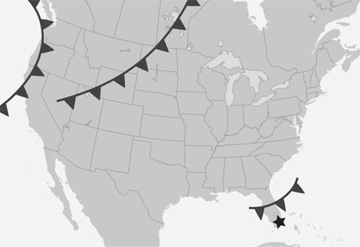
ChemCatalyst (cont.)
Weather map for October 27, 2008:

Slide 6
Key Question
What causes the weather?

Slide 7
You will be able to:
explain the phenomenon of weather in general terms
list the variables meteorologists study or measure in order to predict the weather
describe the basic components of a weather map

Slide 8
Prepare for the Activity
Work in groups of four.
Weather: The state of the atmosphere in a region over a short period of time. Weather is the result of the interaction among Earth, the atmosphere, water, and the Sun. It refers to clouds, winds, temperature, and rainfall or snowfall.

Slide 9
Discussion Notes
Several factors affect the weather in North America.
• jet stream
• temperature
• cloud cover
• fronts
• precipitation
• pressure

Slide 10
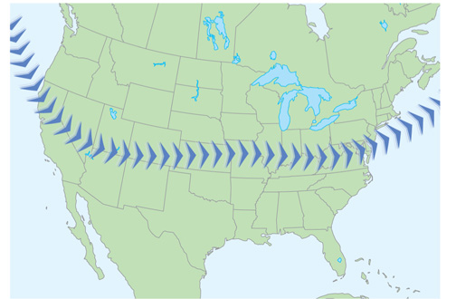
Discussion Notes (cont.)
Jet stream

Slide 11
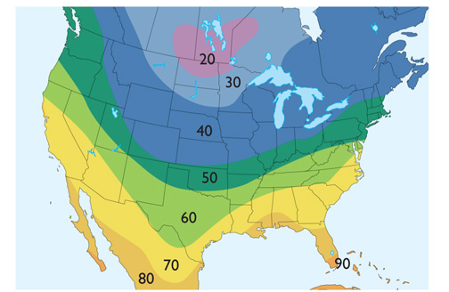
Discussion Notes (cont.)
Temperature highs in degrees Fahrenheit

Slide 12
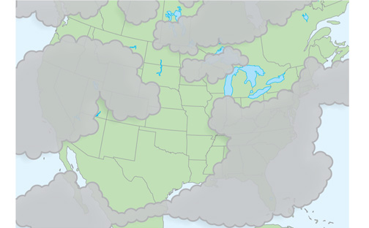
Discussion Notes (cont.)
Cloud cover

Slide 13
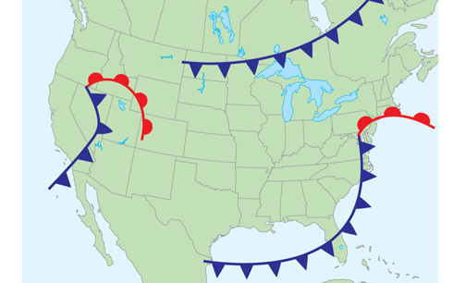
Discussion Notes (cont.)
Fronts

Slide 14
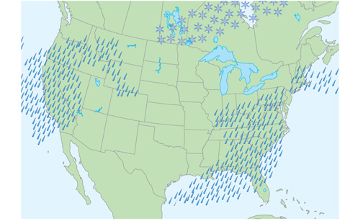
Discussion Notes (cont.)
Precipitation: rain and snow

Slide 15
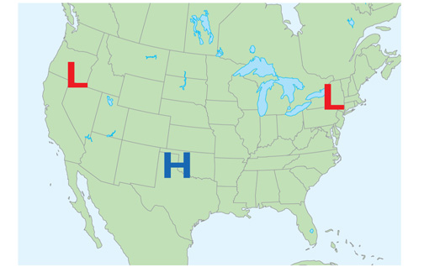
Discussion Notes (cont.)
Air pressure highs and lows

Slide 16
Discussion Notes (cont.)
There are connections between the different maps.
The precipitation map is most closely associated with low-pressure areas and with weather fronts of all kinds.
The curves of the jet stream map generally match the curves of the temperature maps.
The lows on the air pressure map are associated with the warm and cold fronts.
Rain requires clouds overhead. However, the presence of clouds does not necessarily mean precipitation.

Slide 17
Discussion Notes (cont.)
In the jet stream, air moves swiftly from west to east across the United States.

Slide 18
Wrap Up
What causes the weather?
Weather consists of precipitation, clouds, winds, and temperature changes.
Weather is the result of interaction among Earth, the atmosphere, water, and the Sun.
The jet stream, temperature, cloud cover, weather fronts, precipitation, and air pressure are variables that are all tracked by meteorologists in order to forecast the weather.

Slide 19
Check-In
What do weather maps keep track of? How do they help meteorologists?

