Slide 1
Living By Chemistry SECOND EDITION
Unit 2: SMELLS
Molecular Structure and Properties

Slide 2
Lesson 43: Polar Bears and Penguins
Electronegativity and Polarity

Slide 3
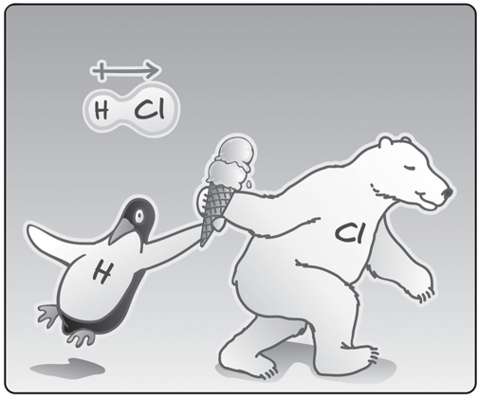
ChemCatalyst
Consider this illustration:
If the penguin represents a hydrogen atom and the polar bear represents a chlorine atom, what does the ice cream represent in the drawing? What do you think the picture is trying to illustrate
2. Would HCl be attracted to a charged wand?
Explain your thinking.

Slide 4
Key Question
What makes a molecule polar?

Slide 5
You will be able to:
explain what causes polarity and polar molecules
describe the different types of bonding that correspond to different combinations of electronegative atoms
predict the general direction and strength of a dipole for any two atoms, using the periodic table

Slide 6
Prepare for the Activity
Work in pairs.

Slide 7
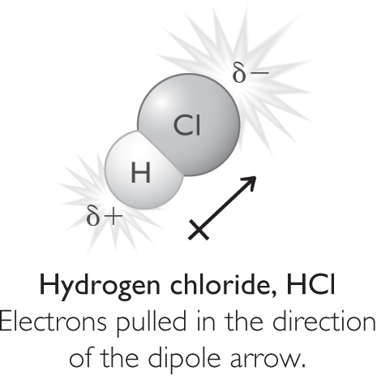
Discussion Notes
The tendency of an atom to attract shared electrons is called electronegativity.
Electronegativity: The tendency of an atom to attract the electrons that are involved in bonding.

Slide 8
Discussion Notes (cont.)
Dipole: A polar molecule or a polar bond between atoms. A crossed arrow is used to show the direction of a dipole. The crossed end of the arrow indicates the partial positive (+) end of the polar bond, and the arrow points in the direction of the partial negative (–) end.

Slide 9
Discussion Notes (cont.)
Bonds that involve sharing or transferring electrons fall into three categories.

Slide 10
Wrap Up
What makes a molecule polar?
Polarity in a molecule is caused by unequal sharing of electrons between atoms.
Electronegativity is the tendency of an atom to attract shared electrons.
Anytime two atoms with different electronegativity values share electrons, there will be a partial negative charge on one atom and a partial positive charge on the other atom.

Slide 11
Wrap Up (cont.)
Bonds are classified as nonpolar covalent, polar covalent, and ionic as the difference in electronegativity between the two atoms in the bond increases.

Slide 12
Check-In
Consider hydrogen iodide, HI.
1. Is HI a polar molecule? Explain your reasoning.
2. How would the atoms be portrayed in the comic strip—as polar bears, penguins, or both? Explain.

