Slide 1
Living By Chemistry SECOND EDITION
Unit 2: SMELLS
Molecular Structure and Properties

Slide 2
Lesson 42: Attractive Molecules
Attractions Between Molecules

Slide 3
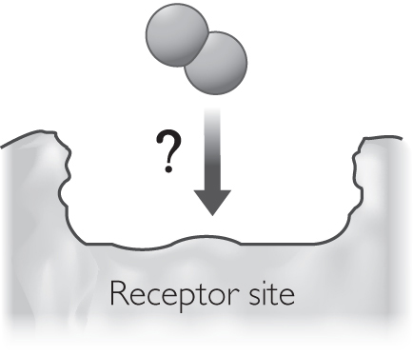
ChemCatalyst
If a molecule fits into a receptor site in the nose, it seems as if it should smell. Yet most of the molecules in air—O₂ (oxygen), N₂ (nitrogen), CO₂ (carbon dioxide), and Ar (argon)—do not have a smell. What do you think is going on?

Slide 4
Key Question
Why do some molecules smell while others do not?

Slide 5
You will be able to:
describe the behavior of polar molecules
explain the general difference between a polar and a nonpolar molecule
describe basic intermolecular attractions
define a partial charge

Slide 6
Prepare for the Lab
Work in groups of four.

Slide 7
Discussion Notes
The charged wand experiment provides evidence that some molecules are attracted to a charge.
Polar molecules: Molecules that are attracted to a charge because they have partial charges on them.
Nonpolar molecules: Molecules that are not attracted to a charge.

Slide 8
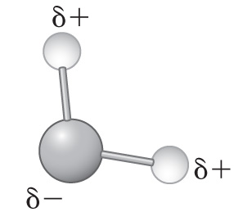
Discussion Notes (cont.)
One end of a polar molecule has a partial negative charge, and the other end of the molecule has a partial positive charge.

Slide 9
Discussion Notes (cont.)
The individual molecules in polar liquids will respond when another charged substance comes near.

Slide 10
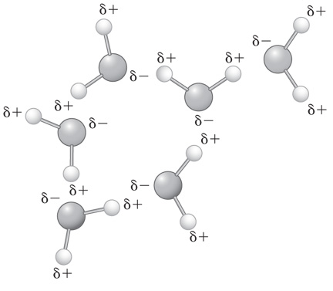
Discussion Notes (cont.)
The partial charges on polar molecules cause individual molecules to be attracted to each other.

Slide 11
Discussion Notes (cont.)
Intermolecular forces: The forces of attraction that occur between molecules.
All molecules interact with each other, but the attractions between polar molecules tend to be stronger than those between nonpolar molecules.

Slide 12
Wrap Up
Why do some molecules smell while others do not?
Polar molecules have partial charges on parts of the molecule.
Polar molecules are attracted to a charge.
Polar molecules are attracted to each other. These intermolecular interactions account for many observable properties.

Slide 13
Check-In
Acetone is polar. Name two other things that are probably true about acetone.

