Slide 1
Living By Chemistry SECOND EDITION
Unit 2: SMELLS
Molecular Structure and Properties

Slide 2
Lesson 41: How Does The Nose Know?
Receptor Site Theory

Slide 3
ChemCatalyst
Suppose you needed to separate coins but could not see them. Explain how you would make a machine that detects and sorts coins.
2. How do you think your nose detects a smell?

Slide 4
Key Question
How does the nose detect and identify different smells?

Slide 5
You will be able to:
come up with a plausible model to explain how smell works in the nose, based on the evidence thus far
describe the receptor site model

Slide 6
Prepare for the Activity
Work in groups of four.

Slide 7
Discussion Notes
Scientists have proposed many theories about how smell works and created models corresponding to these theories.

Slide 8
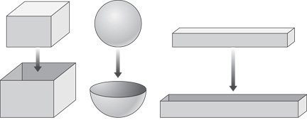
Discussion Notes (cont.)
Receptor site theory: The currently accepted model explaining how smells are detected in the nose. Molecules fit into receptor sites that correspond to the overall shape of the molecule. This stimulates a response in the body.

Slide 9
Wrap Up
How does the nose detect and identify different smells?
The currently accepted model for smell describes smell molecules landing in receptor sites that fit the shape of the smell molecules.
In the receptor site model, each receptor site has a specific shape that corresponds to the shape of just a few smell molecules.

Slide 10
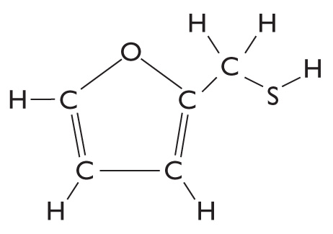
Check-In
One of the molecules that gives coffee its smell is 2-furylmethanethiol.
1. Write down everything you know about how this molecule is detected by the nose.
2. Draw a possible receptor site for this molecule.

