Slide 1
Living By Chemistry SECOND EDITION
Unit 2: SMELLS
Molecular Structure and Properties

Slide 2
Lesson 40: Sorting It Out
Shape and Smell

Slide 3
ChemCatalyst
What smell or smells do you predict for a compound made of molecules that are long and stringy in shape? What is your reasoning?

Slide 4
Key Question
What chemical information is most useful in predicting the smell of a compound?

Slide 5
You will be able to:
summarize the various connections explored so far between molecular structure and smell
predict smells of a wide variety of compounds by examining molecular formulas, chemical names, molecular structures, and molecular shapes

Slide 6
Prepare for the Activity
Work in groups of four.

Slide 7
Discussion Notes
In each smell category, it is possible to find one distinctive feature that sets that group apart from the other smell categories.
How do we need to revise the Smells Summary Chart to bring it up to date?

Slide 8
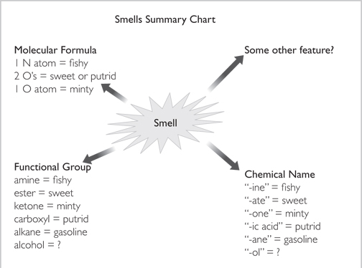
Discussion Notes (cont.)

Slide 9
Wrap Up
What chemical information is most useful in predicting the smell of a compound?
Molecular shape can be useful in predicting smells for sweet-, minty-, and camphor-smelling compounds.
Amines and carboxylic acids have distinctive smells.
For stringy and frying-pan shaped compounds, it is necessary to look at functional group as well as molecular shape in order to determine smell.

Slide 10
Check-In
If a compound is sweet smelling, what other things do you know about it? List at least three things that are probably true.

