Slide 1
Living By Chemistry SECOND EDITION
Unit 2: SMELLS
Molecular Structure and Properties

Slide 2
Lesson 39: What Shape Is That Smell?
Space-Filling Models

Slide 3
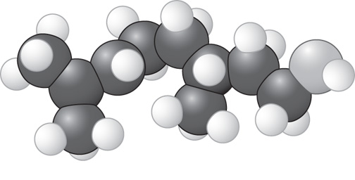
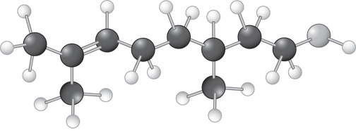
ChemCatalyst
What similarities and differences do you see between these two different types of models?
Space-filling model of citronellol
Ball-and-stick model of citronellol

Slide 4
Key Question
How is the shape of a molecular compound related to its smell?

Slide 5
You will be able to:
build a space-filling molecular model given the structural formula
begin to relate the overall shapes of molecules to their smell categories

Slide 6
Prepare for the Activity
Work in groups of four.

Slide 7
Discussion Notes
A space-filling model is a three-dimensional model that a chemist uses to show how the atoms in a molecule are arranged in space and how they fill this space.
In order to identify the space-filling models, you might have found it useful to start by figuring out the molecular formulas of the models and of the illustrations.
The shape of a molecular compound appears to be directly related to its smell.

Slide 8
Wrap Up
How is the shape of a molecular compound related to its smell?
Space-filling models provide another way of looking at the three-dimensional shape of molecules—one that represents the space occupied by atoms.
Smell appears to be directly related to the three-dimensional molecular shape of a compound.
The shapes of some large molecules can be described as stringy, ball-shaped, or frying pan.

Slide 9
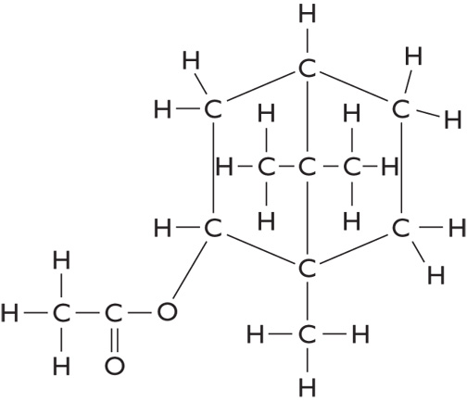
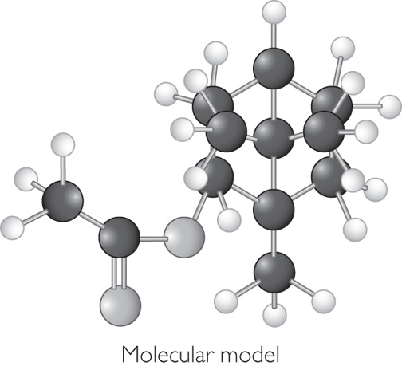
Check-In
What smell do you predict for the substance in vial Y? Explain your reasoning.
Vial Y
Molecular formula: C₁₂H₂₀O₂
Chemical name: bornyl acetate

