Slide 1
Living By Chemistry SECOND EDITION
Unit 2: SMELLS
Molecular Structure and Properties

Slide 2
Lesson 38: Let’s Build It
Molecular Shape

Slide 3
ChemCatalyst
What is the Lewis dot structure of formaldehyde, CH₂O?
Draw formaldehyde’s structural formula.
How many electron domains do you think this molecule has? Explain your reasoning.

Slide 4
Key Question
How can you predict the shape of a molecule?

Slide 5
You will be able to:
predict and explain molecular shape, including in molecules with multiple bonds

Slide 6
Prepare for the Activity
Work in groups of four.
Using the gumdrop, marshmallow, and toothpick kits, build a model of formaldehyde, CH₂O.

Slide 7
Discussion Notes
Double or triple bonding changes the number of electron domains around an atom, affecting the overall shape of a molecule.
Trigonal planar shape: A flat triangular shape found in small molecules with three electron domains surrounding the central atom.

Slide 8
Discussion Notes (cont.)
Linear shape: A geometric shape found in small molecules with two electron domains surrounding the central atom.
The number of electron domains is more important in determining the structure of a molecule than is the number of atoms.

Slide 9
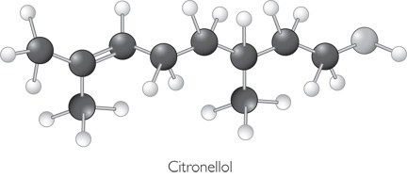
Discussion Notes (cont.)
The more atoms in a molecule, the more combinations of shapes you might see together.

Slide 10
Wrap Up
How can you predict the shape of a molecule?
Drawing the Lewis dot structure of a molecule allows us to predict its three dimensional shape.
The presence of double or triple bonds changes the number of electron domains around an atom, which in turn affects the overall shape of the molecule.
The shape of large molecules is determined by the smaller shapes around individual atoms.

Slide 11
Check-In
What is the shape of this molecule?
H₂S

