Slide 1
Living By Chemistry SECOND EDITION
Unit 2: SMELLS
Molecular Structure and Properties

Slide 2
Lesson 37: Two’s Company
Electron Domains

Slide 3
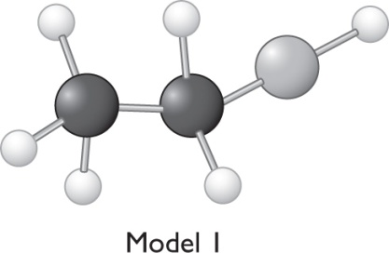
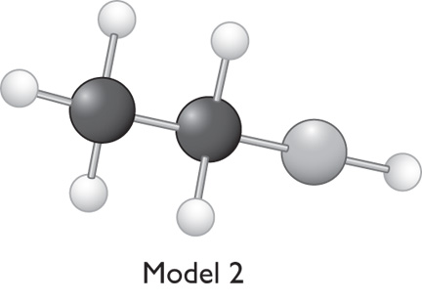
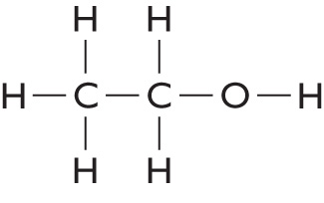
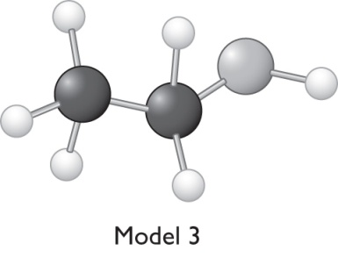
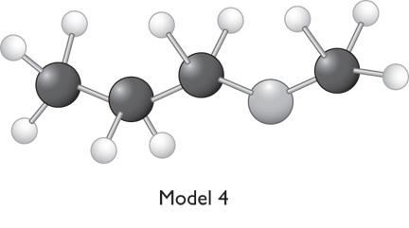
ChemCatalyst
Examine the structural formula of ethanol. Which is the correct ball-and-stick model for ethanol? Explain your reasoning.

Slide 4
Key Question
How do electrons affect the shape of a molecule?

Slide 5
You will be able to:
determine the shapes of small molecules
explain how lone pairs of electrons influence molecular shape
describe electron domain theory and how it relates to molecular shape

Slide 6
Prepare for the Activity
Work in pairs.

Slide 7
Discussion Notes
The overall geometric shape of a methane model is tetrahedral.
In contrast, the bonding pairs are not equidistant from one another in a cross arrangement.

Slide 8
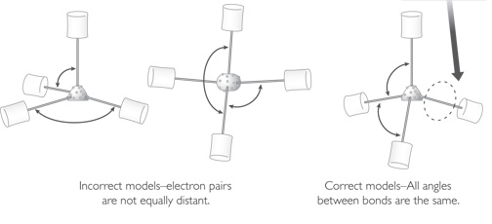
Discussion Notes (cont.)
This area is an electron domain
Incorrect models–electron pairs are not equally distant.
Correct models–All angles between bonds are the same.

Slide 9
Discussion Notes (cont.)
Tetrahedral shape: The shape around an atom with four bonded pairs of electrons. This is the shape of a methane molecule.
An electron domain describes the area occupied by a set of electrons in a bond or a lone pair.

Slide 10
Discussion Notes (cont.)
Electron domain: The space occupied by valence electrons in a molecule, either a bonded pair(s) or a lone pair. Electron domains affect the overall shape of a molecule.
Electron domain theory: The idea that every electron domain in a molecule is as far as possible from every other electron domain in that molecule.

Slide 11
Discussion Notes (cont.)
Even though the molecules you created today have different numbers of atoms, they all have a similar underlying shape.
CH4 NH3 H2O HF Ne

Slide 12
Discussion Notes (cont.)
Most molecular models do not include lone pair paddles in their representations.

Slide 13
Discussion Notes (cont.)
Pyramidal shape: The shape around an atom with one lone pair of electrons. This is the shape of an ammonia molecule.
Bent shape: The shape around an atom with two lone pairs of electrons. This is the characteristic shape of a water molecule.

Slide 14
Wrap Up
How do electrons affect the shape of a molecule?
Electron domains represent the space occupied by bonded electrons or a lone pair.
Electron domains are located as far apart from one another as possible. This is referred to as electron domain theory.
The three-dimensional shape of a molecule is determined by the valence electrons, both bonding electrons and lone pairs.

Slide 15
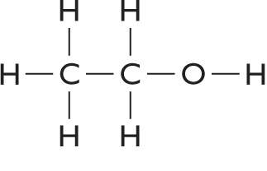
Check-In
Use your model kit to build a model for ethanol. Be sure to use lone pairs to help you with your overall structure.

