Slide 1
Living By Chemistry SECOND EDITION
Unit 2: SMELLS
Molecular Structure and Properties

Slide 2
Lesson 36: New Smells, New Ideas
Ball-and-Stick Models

Slide 3
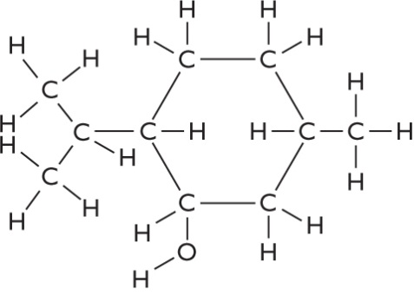
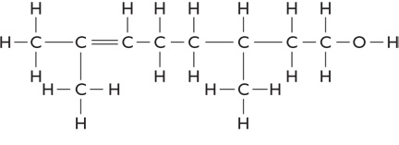
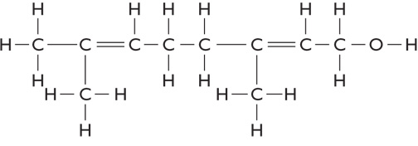
ChemCatalyst
Do you think any of these molecules will smell similar? What evidence do you have to support your prediction?
citronellol C₁₀H₂₀O
menthol C₁₀H₂₀O
geraniol C₁₀H₁₈O

Slide 4
Key Question
What three-dimensional features of a molecule are important in predicting smell?

Slide 5
You will be able to:
visually interpret three-dimensional ball-and-stick molecular representations
translate between molecular models, molecular formulas, and structural formulas
describe connections between molecular properties and molecular structure

Slide 6
Prepare for the Activity
Work in groups of four.

Slide 7
Discussion Notes
Each molecule in the activity has a hydroxyl group (–OH) and is an alcohol, but the molecules do not all smell the same.
There are a number of similarities among those alcohols that smell similar.

Slide 8
Discussion Notes (cont.)
A ball-and-stick model shows the three- dimensional shape of a molecule.
Ball-and-stick model: A three-dimensional representation of a molecule that uses sticks to represent bonds and color-coded balls to represent atoms.
It is hard to tell at this point whether the shape of a molecule is related to its smell.

Slide 9
Wrap Up
What three-dimensional features of a molecule are important in predicting smell?
Molecular formula and functional group are not always sufficient information to predict the smell of a molecule accurately.
A ball-and-stick model is a three-dimensional representation of a molecule that shows us how the atoms are arranged in space in relationship to one another.
It appears that the smell of a compound may be related to its overall shape.

Slide 10
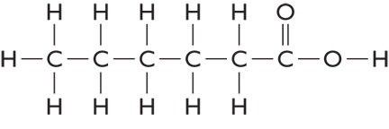
Check-In
Predict the smells of these molecules.
1. Propyl butyrate
2. C₆H₁₄O 3.

