Slide 1
Living By Chemistry SECOND EDITION
Unit 2: SMELLS
Molecular Structure and Properties

Slide 2
Lesson 33: Where’s the Fun?
Functional Groups

Slide 3
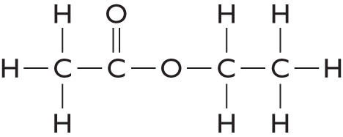
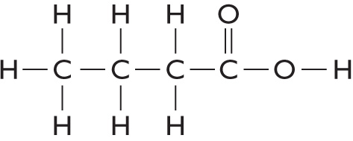
ChemCatalyst
Consider the following compounds. List at least three differences and three similarities between the two molecules.
Molecule 1 Molecule 2

Slide 4
Key Question
What does the structure of a molecule have to do with smell?

Slide 5
You will be able to:
identify and name basic functional groups within molecules
relate certain functional groups to certain smell categories
describe the naming patterns found among molecules associated with specific functional groups
deduce the probable smell of a compound from its name or structural formula

Slide 6
Prepare for the Activity
Work in pairs.

Slide 7
Discussion Notes
A number of patterns emerge from the card sort.
Each group of molecules with a similar smell has something identical in its structure.

Slide 8
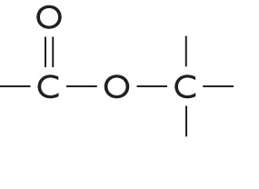
Discussion Notes (cont.)
This feature is found in all the sweet-smelling molecules in our sample.

Slide 9
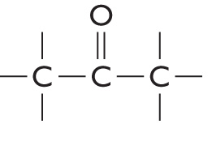
Discussion Notes (cont.)
This feature is found in all the minty-smelling molecules in our sample.

Slide 10
Discussion Notes (cont.)
Functional group: A cluster of atoms in a molecule that is responsible for many of its properties.
The functional groups have names, and molecules frequently are named according to the functional groups they contain.

Slide 11
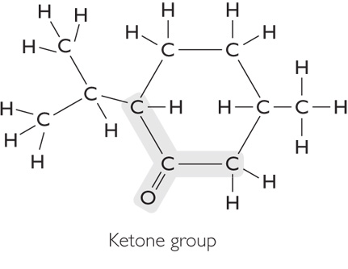
Discussion Notes (cont.)

Slide 12
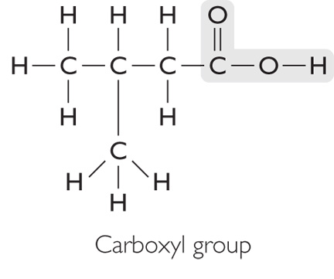
Discussion Notes (cont.)

Slide 13
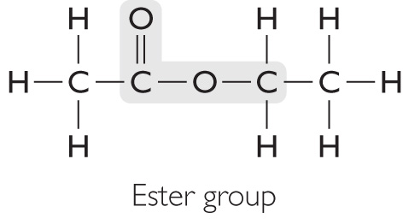
Discussion Notes (cont.)

Slide 14
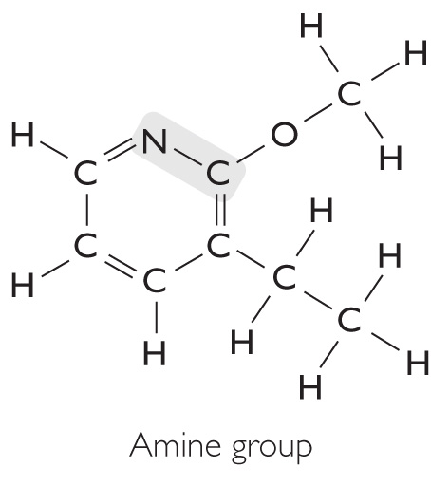
Discussion Notes (cont.)

Slide 15
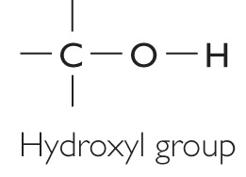
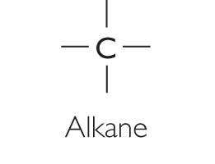
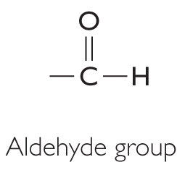
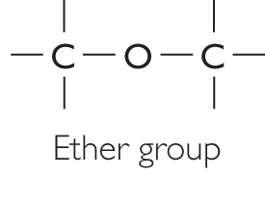
Discussion Notes (cont.)
There are other functional groups.

Slide 16
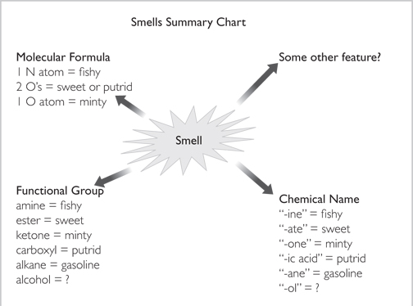
Discussion Notes (cont.)

Slide 17
Wrap Up
What does the structure of a molecule have to do with smell?
Functional groups are structural features that show up repeatedly in molecules and seem to account for some of their chemical properties.
Molecules containing the same functional groups have similar smells.
The chemical names of molecules are often related to the functional groups they contain. Thus, chemical name is related to smell.

Slide 18
Check-In
If a molecule is sweet-smelling, what other things do you know about it? List at least three things that are probably true.

