Slide 1
Living By Chemistry SECOND EDITION
Unit 2: SMELLS
Molecular Structure and Properties

Slide 2
Lesson 30: HONC if You Like Molecules
Bonding Tendencies

Slide 3
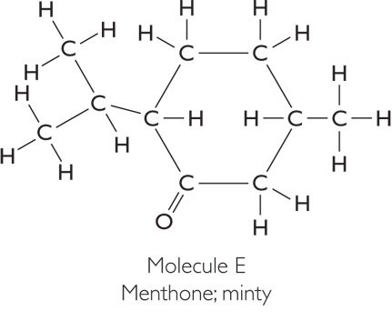
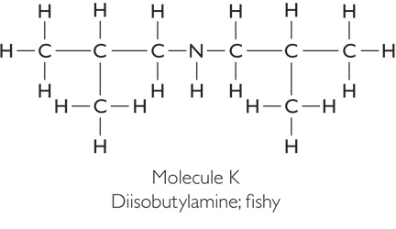
ChemCatalyst
Examine these molecules. What patterns do you see in the bonding of atoms of hydrogen, oxygen, carbon, and nitrogen?

Slide 4
Key Question
What are the rules for drawing structural formulas?

Slide 5
You will be able to:
create accurate structural formulas from molecular formulas
identify and differentiate between isomers and molecules oriented differently in space
explain and utilize the HONC 1234 rule

Slide 6
Prepare for the Activity
Work in pairs.
Examine the HONC, 1234 Rule
Element | # | Description
Hydrogen | 1
Oxygen | 2
Nitrogen | 3
Carbon | 4

Slide 7
Discussion Notes
The HONC 1234 rule is a way to remember the bonding tendencies of hydrogen, oxygen, nitrogen, and carbon atoms in molecules. Hydrogen tends to form one bond, oxygen two, nitrogen three and carbon four.
When trying to decide whether two structures represent the same molecule, you must check how the atoms are connected.

Slide 8
Wrap Up
What are the rules for drawing structural formulas?
The HONC 1234 rule indicates how many times hydrogen, oxygen, nitrogen, and carbon atoms tend to bond.
When a molecule is oriented differently in space, it is still the same molecule.

Slide 9
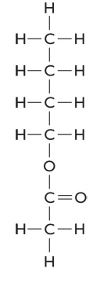
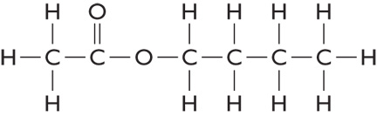
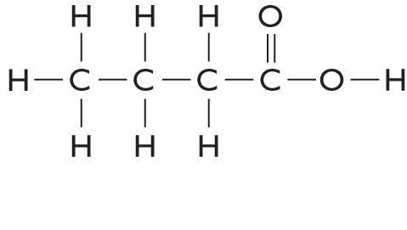
Check-In
Will any of the molecules shown on the following slide have similar smells? Explain your thinking.

