Slide 1
Living By Chemistry SECOND EDITION
Unit 2: SMELLS
Molecular Structure and Properties

Slide 2
Lesson 29: Molecules in Two Dimensions
Structural Formulas

Slide 3
ChemCatalyst
Predict the smells of these three new molecules. Provide evidence to support your prediction.
Vial F: ethyl pentanoate | C₇H₁₄O₂
Vial G: butyric acid | C₄H₈O₂
Vial H: ethyl acetate | C₄H₈O₂

Slide 4
Key Question
How can molecules with the same molecular formula be different?

Slide 5
You will be able to:
describe the difference between structural formulas and molecular formulas
recognize isomers

Slide 6
Prepare for the Activity
Work in groups of four.

Slide 7
Discussion Notes
Even though the molecules in vials G and H have identical molecular formulas, they have different smells and therefore must be different somehow.
A structural formula is a two-dimensional drawing of a molecule showing how the atoms in a molecule are connected.

Slide 8
Discussion Notes (cont.)
Structural formula: A drawing or diagram that a chemist uses to show how the atoms in a molecule are connected. Each line represents a covalent bond.
There are several ways to draw the same structural formula without changing the identity of the molecule.

Slide 9
Discussion Notes (cont.)
When two molecules have the same molecular formula but different structural formulas, they are called isomers of each other.
Isomers: Molecules with the same molecular formula but different structural formulas.

Slide 10
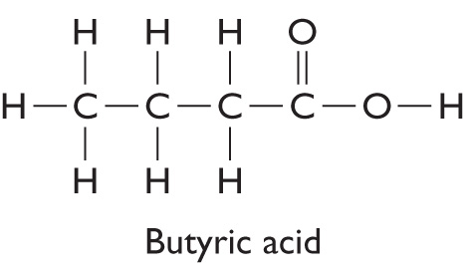
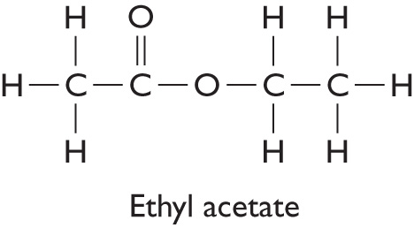
Discussion Notes (cont.)

Slide 11
Discussion Notes (cont.)
Molecules can smell different even if they have the same molecular formula.
Molecules can smell similar even if they have different molecular formulas.

Slide 12
Wrap Up
How can molecules with the same molecular formula be different?
Structural formulas show how the atoms in a molecule are connected.
A molecular formula can be associated with more than one structural formula.
Isomers are molecules with identical molecular formulas but different structural formulas.
The smell of a molecule is a property that appears to be related to its structure.

Slide 13
Check-In
For each compound, predict the smell or describe what information you would want in order to predict the smell.
a. C6H12O2 b. C6H15N

