Slide 1
Living By Chemistry SECOND EDITION
Unit 1: ALCHEMY
Matter, Atomic Structure, and Bonding

Slide 2
Lesson 27: Electrons on the Move
Electroplating Metals

Slide 3
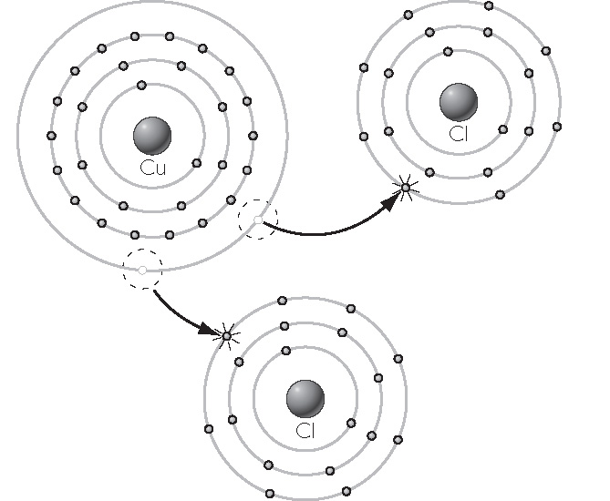
ChemCatalyst
1. What is the charge on the copper ions in this copper chloride compound?
2. How do you think we could get solid copper from a sample of copper (II) sulfate, CuSO₄?
Copper and chlorine atoms combine to form copper (II) chloride.

Slide 4
Key Question
How can you extract an element from a compound?

Slide 5
You will be able to:
assemble an electroplating apparatus
explain how to extract elemental metal from an ionic compound through electroplating

Slide 6
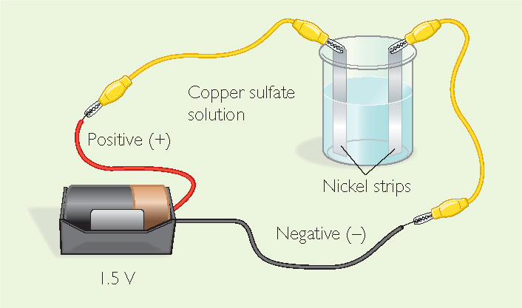
Prepare for the Lab
Work in pairs. Wear safety goggles at all times.
The solution contains acid, which is corrosive. Before handling the nickel strip, rinse it with water.

Slide 7
Discussion Notes
It is possible to transform metal cations in solution into neutral metal atoms, using electricity.

Slide 8
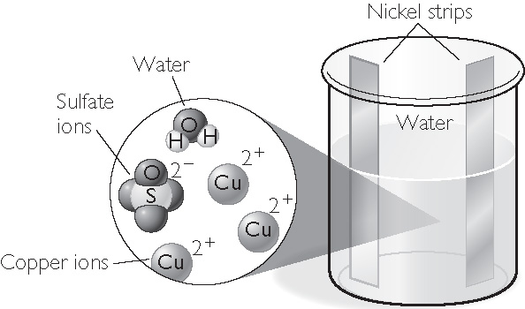
Discussion Notes (cont.)
Aqueous copper (II) sulfate, CuSO₄(aq), is really copper cations, Cu²⁺, and sulfate anions, SO₄^{2–}.
Before connecting to the battery

Slide 9
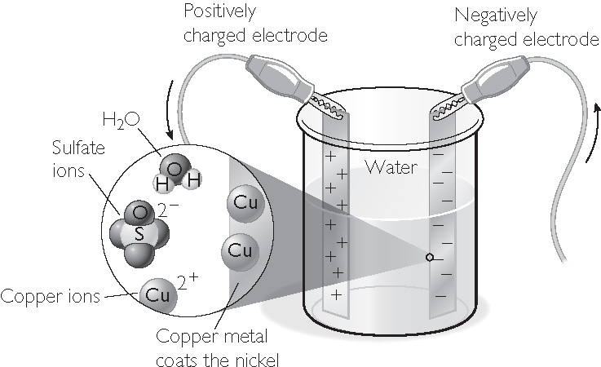
Discussion Notes (cont.)
Once the battery is hooked up, one nickel strip has a positive charge, and the other has a negative charge.
After connecting to the battery

Slide 10
Discussion Notes (cont.)
Many elements are found in nature only in combination with other atoms in compounds.
While you cannot make gold by moving electrons, you can plate thin layers of gold onto jewelry.

Slide 11
Wrap Up
How can you extract an element from a compound?
Atoms are not destroyed when they combine to form compounds. Matter is conserved.
Ions are simply atoms or groups of atoms with charges on them because they either are missing electrons or have extra electrons.
Elements can be extracted from ionic compounds by moving electrons between atoms.

Slide 12
Check-In
What is required to transform CuCl₂(aq) into Cu(s)?
What is required to transform CuCl₂(aq) into Au(s)?

