Slide 1
Living By Chemistry SECOND EDITION
Unit 1: ALCHEMY
Matter, Atomic Structure, and Bonding

Slide 2
Lesson 24: Shell Game
Electron Configurations

Slide 3
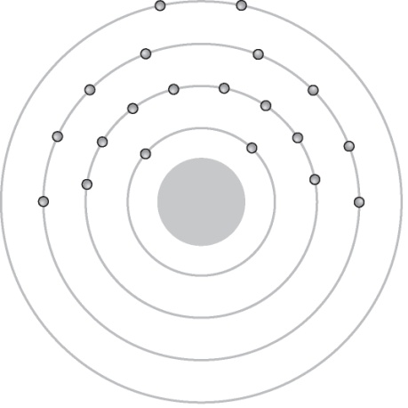
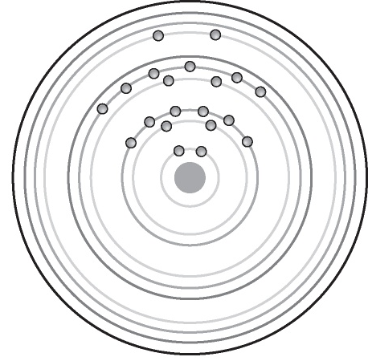
ChemCatalyst
These drawings show two different ways to represent the arrangement of the electrons in atoms of the element calcium, Ca.
1. Name at least two differences in the drawings.
2. Name at least two similarities in the drawings.

Slide 4
Key Question
What does the periodic table indicate about the arrangements of electrons?

Slide 5
You will be able to:
describe the structure of an atom in terms of electron shells and subshells
use the periodic table to determine the electron arrangement in an atom and to write electron configurations
explain the organization of the periodic table in terms of the arrangements of electrons in subshells

Slide 6
Prepare for the Activity
Work in pairs.

Slide 7
Discussion Notes
The electron shells in the shell model of an atom (except for n = 1) are divided into subshells.
Shell | Number of electrons in the shell | Subshell | Number of electrons in the subshell
n = 1 | 2 | 1s | 2
n = 2 | 8 | 2s 2p | 2 6
n = 3 | 18 | 3s 3p 3d | 2 6 10
n = 4 | 32 | 4s 4p 4d 4f | 2 6 10 14

Slide 8
Discussion Notes (cont.)
In an electron configuration, the number indicates the shell number, the letter indicates the subshell within the shell, and the superscript indicates the number of electrons in the subshell.
Electron configuration: A shorthand way to keep track of all the electrons in an atom of an element for all the subshells that have electrons. The number of electrons in each subshell is shown as a superscript.

Slide 9
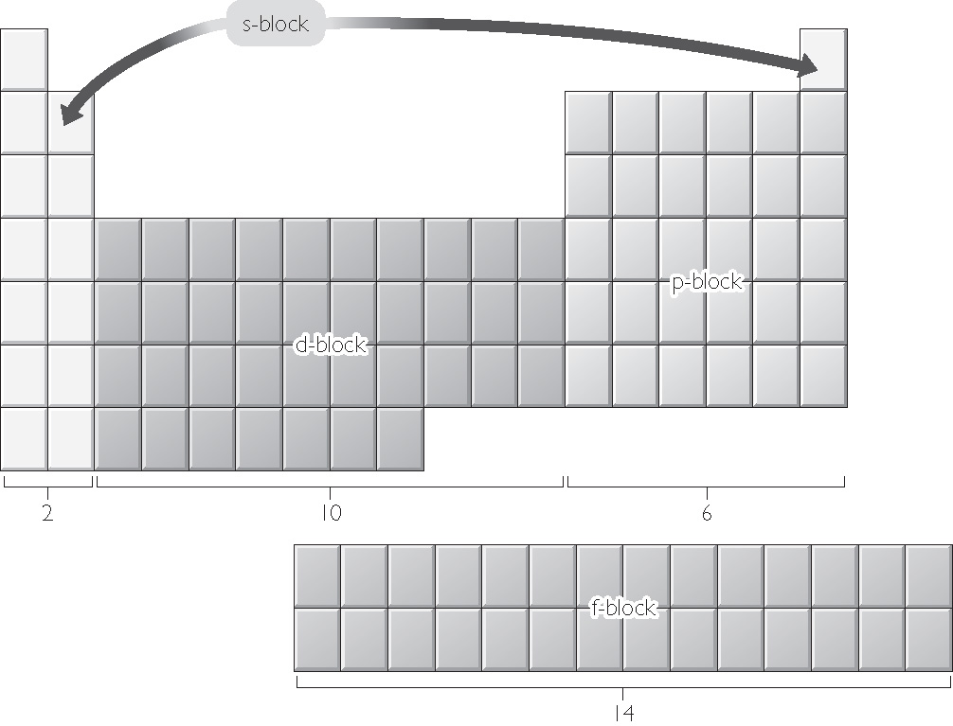
Discussion Notes (cont.)
The periodic table is organized in subshell blocks.

Slide 10
Discussion Notes (cont.)
The order of filling subshells does not always correspond to the numerical order of the subshells.
The elements in the different subshell blocks have related properties.

Slide 11
Wrap Up
What does the periodic table indicate about the arrangements of electrons?
Each electron shell in the shell model, except for n = 1, is divided into subshells.
Each subshell can hold a specific maximum number of electrons.
The periodic table can assist you in figuring out the placement of electrons in subshells.
Chemists keep track of electrons and the subshells they are in by writing electron configurations.

Slide 12
Check-In
Identify the element with this electron configuration:
1s²2s²2p⁶3s²3p⁶4s²3d¹⁰4p³

