Slide 1
Living By Chemistry SECOND EDITION
Unit 1: ALCHEMY
Matter, Atomic Structure, and Bonding

Slide 2
Lesson 23: Alchemy of Paint
Transition Metal Chemistry

Slide 3
ChemCatalyst
What types of substances will you be creating in today’s lab?
What safety precautions are especially important for today’s lab?
Describe one of the procedures you will be completing in class today.

Slide 4
Key Question
What types of compounds are made from transition metals?

Slide 5
You will be able to:
recognize transition metal compounds and their names
determine the charge on transition metal ions given their chemical formula

Slide 6
Prepare for the Lab
Work in groups of four.
You will be working with transition metal compounds and acid. Follow lab safety guidelines.
Wear safety goggles at all times.
When heating compounds in a test tube, keep the open end pointed away from yourself and others.
If any compound comes in contact with your skin, wash immediately with plenty of water.
Tie back long hair and loose clothing. Remove any dangling jewelry.

Slide 7
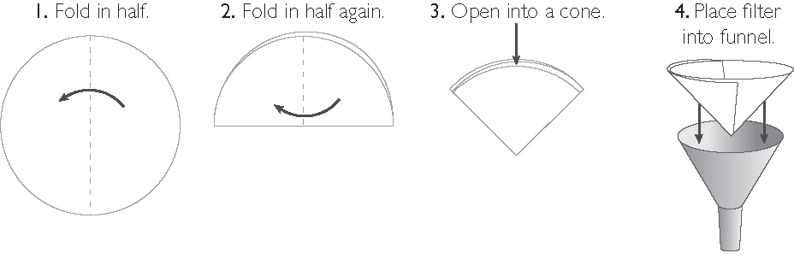
Prepare for the Lab (cont.)
To decant and filter a solid, fold filter paper following instructions.

Slide 8
Discussion Notes
Many of the paint pigments that artists historically used and continue to use are ionic metal-nonmetal compounds.

Slide 9
Wrap Up
What types of compounds are made from transition metals?
Many of the colorful pigments used in painting are formed from metal-nonmetal compounds with transition metal cations.
Paint pigments in famous paintings can be as valuable as gold. A compound or element does not have to be gold to be valuable.

