Slide 1
Living By Chemistry SECOND EDITION
Unit 1: ALCHEMY
Matter, Atomic Structure, and Bonding

Slide 2
Lesson 22: Isn’t It Ionic?
Polyatomic Ions

Slide 3
ChemCatalyst
The cards show a sodium ion and three polyatomic ions.
What do you think a polyatomic ion is?
Name three compounds formed between sodium ions and each of the three polyatomic ions. Use the rule of zero charge to write the compounds’ formulas.

Slide 4
Key Question
What is a polyatomic ion?

Slide 5
You will be able to:
recognize and name polyatomic ions
write names and chemical formulas of compounds with polyatomic ions

Slide 6
Prepare for the Activity
Work in pairs.
Ionic compound: An ionic compound is a compound composed of positive and negative ions, formed when metal and nonmetal atoms combine.

Slide 7
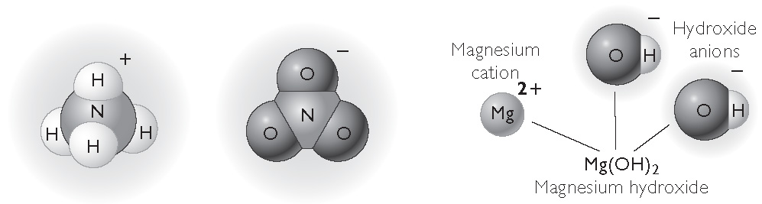
Discussion Notes
Polyatomic Ions

Slide 8
Discussion Notes (cont.)
Polyatomic ions contain more than one atom.
Most polyatomic ions are anions, with negative charges.
Polyatomic ion: An ion composed of a group of atoms with an overall positive or negative charge. Most polyatomic ions are anions.

Slide 9
Discussion Notes (cont.)
The rule of zero charge can be used to predict the formulas of compounds that contain polyatomic ions.

Slide 10
Discussion Notes (cont.)
Compounds containing polyatomic ions have their own unique naming guidelines.
Polyatomic ion | Name
OH– | hydroxide
NO₃– | nitrate
CO₃^{2–} | carbonate
SO₄^{2–} | sulfate
NH₄⁺ | ammonium

Slide 11
Wrap Up
What is a polyatomic ion?
Polyatomic ions are ions composed of a group of atoms. The charge is shared by all the atoms.
To write the formula of an ionic compound that contains polyatomic ions, use the rule of zero charge.
When naming compounds containing polyatomic ions, simply insert the name of the ion.

Slide 12
Check-In
What is the name of the compound Be(NO₃)₂?
What ions are present in this compound, and what are the charges on the ions?

