Slide 1
Living By Chemistry SECOND EDITION
Unit 1: ALCHEMY
Matter, Atomic Structure, and Bonding

Slide 2
Lesson 21: Salty Eights
Formulas for Ionic Compounds

Slide 3
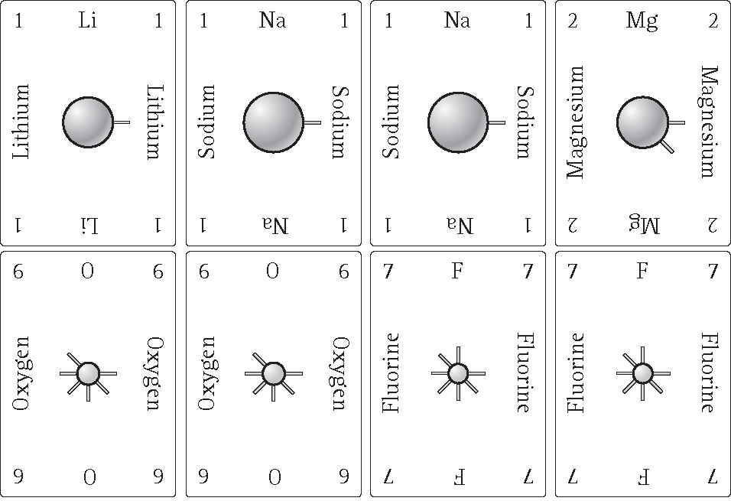
ChemCatalyst
Find these cards in
Your Salty Eights
card deck.
1. List the ionic compounds you can make with pairs of cards, using two different elements.
2. List the ionic compounds you can make with three cards and only two different elements.
3. What rule must all these compounds satisfy?

Slide 4
Key Question
How can you predict chemical formulas and name ionic compounds?

Slide 5
You will be able to:
use valence electrons to predict ionic compounds
develop proficiency at naming binary ionic compounds and writing their chemical formulas

Slide 6
Prepare for the Activity
Work in groups of four.

Slide 7
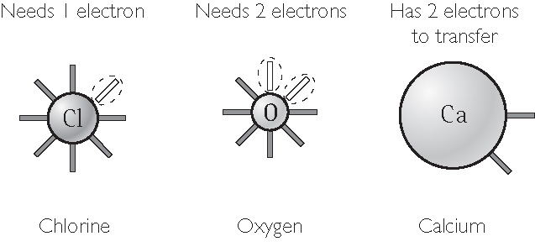
Discussion Notes
In general, atoms come together to form an ionic compound if the number of valence electrons totals 8 or a multiple of 8.

Slide 8
Discussion Notes (cont.)
Writing correct chemical formulas is a matter of keeping track of exactly how many atoms come together to make a compound.
Creating correct chemical names is a matter of remembering some basic guidelines.

Slide 9
Wrap Up
How can you predict chemical formulas and name ionic compounds?
Ionic compounds tend to form from atoms that together have a total of 8 (or a multiple of 8) electrons in their outermost (valence) shells.
Noble gases already have eight valence electrons and don’t combine with other elements to make new compounds. They are already highly stable.

Slide 10
Check-In
Which of these compounds are likely to form?
Na₂S b. K₂Mg c. AlBr₂
d. Na₃N e. OCl f. CaO

