Slide 1
Living By Chemistry SECOND EDITION
Unit 1: ALCHEMY
Matter, Atomic Structure, and Bonding

Slide 2
Lesson 19: Noble Gas Envy
Ions

Slide 3
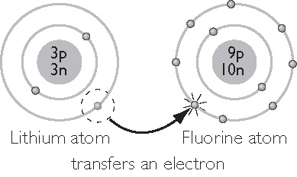
ChemCatalyst
Chemists have found that metal atoms transfer electrons to nonmetal atoms when they form compounds. Examine the shell model showing how a lithium atom might transfer an electron to a fluorine atom.
What effect does this electron transfer have on the charge of each atom?
What element does each atom resemble after the electron has been transferred?

Slide 4
Key Question
How is chemical stability related to the arrangements of electrons in atoms?

Slide 5
You will be able to:
explain that an ion is formed when an atom loses or gains electrons and state the difference between a cation and an anion
determine the charge on an ion based on an atom’s placement in the periodic table
explain the relationship between ion charge and valence electrons

Slide 6
Prepare for the Activity
Work in groups of eight.
Ion: An atom (or group of atoms) that has a positive or negative charge because it has lost or gained electrons.

Slide 7
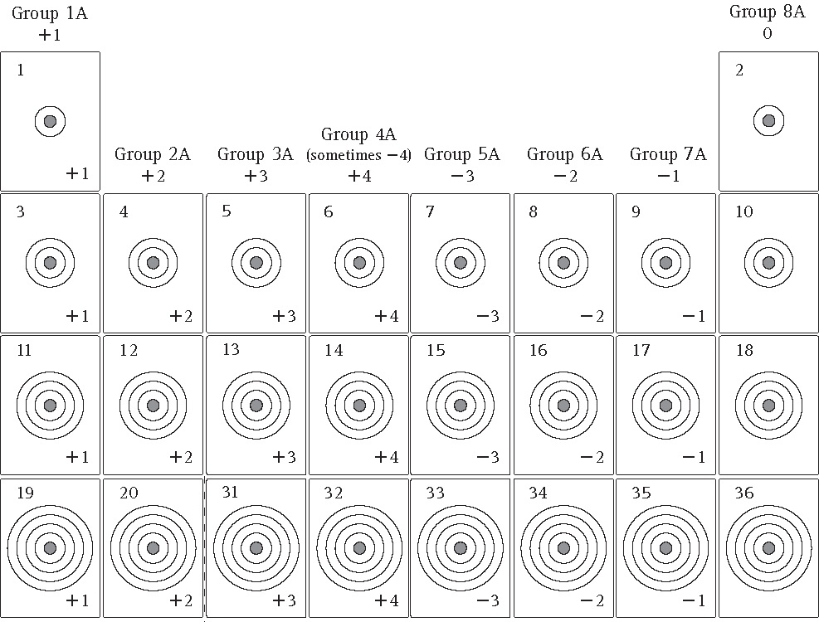
Discussion Notes
The table of arranged ion cards shows that the charges on ions are quite predictable.

Slide 8
Discussion Notes (cont.)
When electrons are removed from or added to an atom, the rest of the atom stays the same.
The charge on an ion is noted with a superscript.

Slide 9
Discussion Notes (cont.)
Cation: An ion with a net positive charge. Usually these are formed from metal atoms.
Anion: An ion with a net negative charge. Usually these are formed from nonmetal atoms.

Slide 10
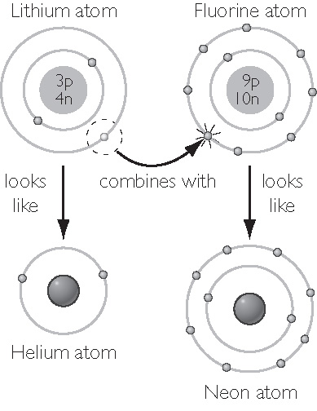
Discussion Notes (cont.)
Electron arrangements of atoms in ionic compounds resemble noble gases.

Slide 11
Discussion Notes (cont.)
Atoms tend to lose or gain electrons to attain the electron arrangement of a noble gas.

Slide 12
Wrap Up
How is chemical stability related to the arrangements of electrons in atoms?
When atoms gain or lose electrons, they form ions. Ions are atoms that carry a net positive or net negative charge.
When atoms lose electrons, they have a positive charge and are called cations.
When atoms gain electrons, they have a negative charge and are called anions.
Ions have electron arrangements resembling those of the noble gas atoms.

Slide 13
Check-In
Draw a shell model for calcium, Ca, showing the arrangement of its electrons.
What would have to happen for an atom of calcium to have an electron arrangement like that of a noble gas? Explain.

