Slide 1
Living By Chemistry SECOND EDITION
Unit 1: ALCHEMY
Matter, Atomic Structure, and Bonding

Slide 2
Lesson 18: Life on the Edge
Valence and Core Electrons

Slide 3
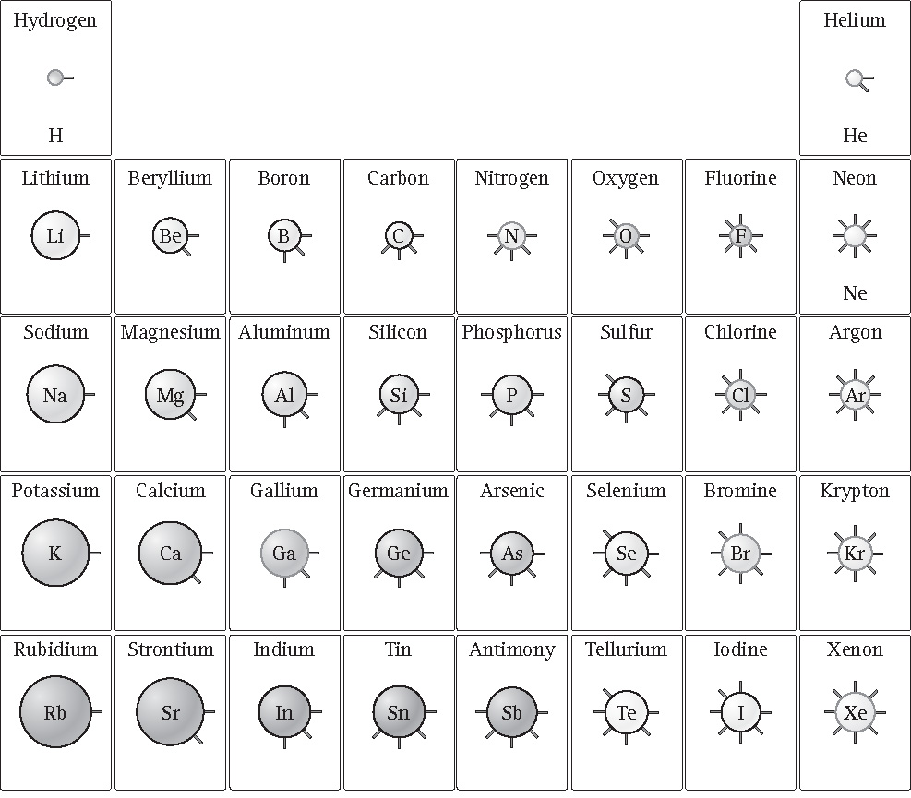
ChemCatalyst
What do you notice about the number of spokes on the circles?
The spokes represent electrons. Do the spokes represent the total number of electrons? Explain your thinking.

Slide 4
Key Question
Why do elements in the same group in the periodic table have similar properties?

Slide 5
You will be able to:
create a shell model diagram of an atom, placing the correct number of electrons in the correct shells
explain the difference between a valence electron and a core electron
describe the patterns in the periodic table associated with electron arrangements

Slide 6
Prepare for the Activity
Work in pairs.

Slide 7
Prepare for the Activity (cont.)
The Shell Model
The surface of each sphere represents an area where an electron or a group of electrons is most likely to be found.

Slide 8
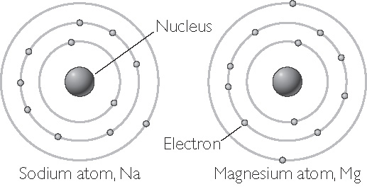
Prepare for the Activity (cont.)
Electron shells are the levels around the nucleus where electrons can be found.
Sodium and magnesium have electrons in three electron shells.

Slide 9
Discussion Notes
The atomic number of an element is the same as the total number of electrons.
The period (row) number of the element is the same as the number of electron shells.
For main-group elements, the group number of the element is the same as the number of electrons in the outermost shell.

Slide 10
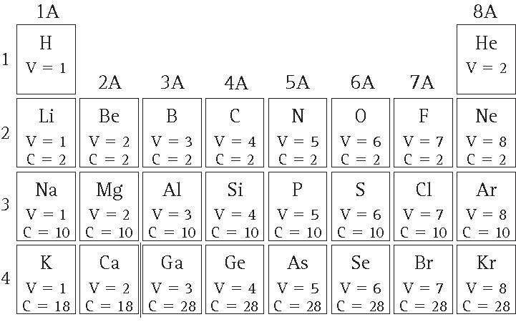
Discussion Notes (cont.)
Table of Valence and Core Electrons

Slide 11
Discussion Notes (cont.)
Valence shell: The outermost electron shell in an atom.
Valence electrons: The electrons located in the outermost electron shell of an atom.
Core electrons: All other electrons in an atom besides the valence electrons.

Slide 12
Discussion Notes (cont.)
The arrangement of electrons in their shells is highly predictable.
The numbers of core electrons also exhibit patterns across each row of the periodic table.

Slide 13
Wrap Up
Why do elements in the same group in the periodic table have similar properties?
Electrons occupy distinct areas around the nucleus called electron shells. The arrangement of electrons in these shells is highly predictable.
For main group elements, elements in the same group have the same number of valence electrons.
The number of valence electrons increases across a period.
The number of shells and the number of core electrons increase as you go down a group.

Slide 14
Check-In
Provide each piece of information for element 34.
a. The element’s name and symbol.
b. The total number of electrons in an atom of this element.
c. The number of core electrons in an atom of this element.
d. The number of valence electrons.
e. The group number for this element.
f. The names of other elements with the same number of valence electrons.

