Slide 1
Living By Chemistry SECOND EDITION
Unit 1: ALCHEMY
Matter, Atomic Structure, and Bonding

Slide 2
Lesson 17: Technicolor Atoms
Flame Tests

Slide 3
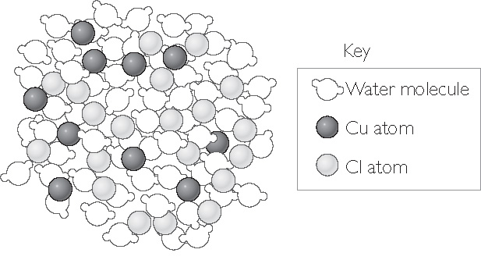
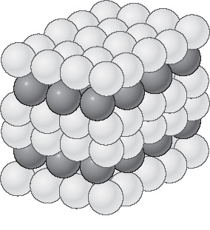
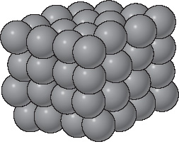
ChemCatalyst
These drawings are models that show solid copper, solid copper chloride, and aqueous copper chloride as collections of atoms.
1. Describe each model.
2. What is similar about each model? What is different?
Cu(s)
Solid copper
CuCl2(s)
Solid copper (II) chloride
CuCl2(aq)
Aqueous copper (II) chloride

Slide 4
Key Question
What evidence is there that certain atoms are present in a compound?

Slide 5
You will be able to:
conduct a flame test and use the results to determine the identity of a compound
interpret evidence of the presence of certain atoms within compounds

Slide 6
Prepare for the Lab
Work in groups.
You will be using chemicals and fire today. Follow safety instructions.
Wear safety goggles.
Tie back long hair and remove dangling jewelry.
Roll up long sleeves and keep clothing away from flames.
Locate the eye wash, fire blanket, and fire extinguisher before starting the lab.

Slide 7
Discussion Notes
The metal element in each chemical formula appears to be responsible for the flame colors.
Only certain elements produce colorful flames.
Flame test: A test used in the laboratory to look for the presence of certain metal atoms. A sample of a compound is heated in a flame, and the resulting color is noted.

Slide 8
Discussion Notes (cont.)
Elements and compounds are collections of atoms.
The only way to change one atom into another is to change the nucleus through a nuclear reaction.

Slide 9
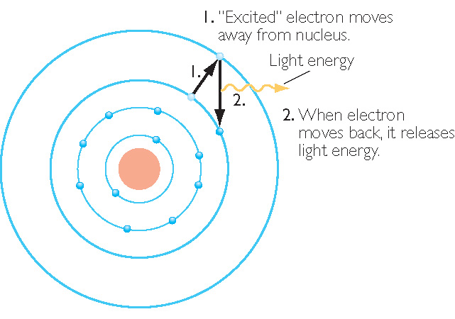
Discussion Notes (cont.)
Sodium Atom, Na

Slide 10
Discussion Notes (cont.)
The illustration indicates that the flame colors are associated with movements of the electrons within the sodium atom.
Bohr’s model of the atom came directly from evidence similar to that produced in class today.

Slide 11
Wrap Up
What evidence is there that certain atoms are present in a compound?
Many metal atoms produce a characteristic colored flame when compounds containing those atoms are heated in a flame.
Flame tests are evidence that elements and compounds are collections of atoms.

Slide 12
Check-In
Predict the flame colors produced when heating these substances. Explain your thinking.
• copper (II) carbonate
• calcium chloride

