Slide 1
Living By Chemistry SECOND EDITION
Unit 1: ALCHEMY
Matter, Atomic Structure, and Bonding

Slide 2
Lesson 16: Old Gold
Formation of Elements

Slide 3
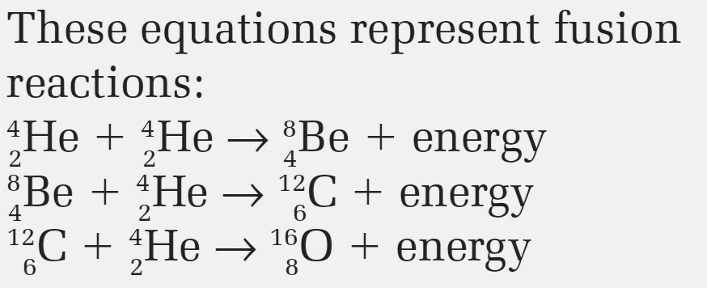
ChemCatalyst
1. What patterns do you notice in the fusion reactions?
2. Do you think gold can be created on Earth by a fusion reaction? Explain your thinking.

Slide 4
Key Question
How are new elements formed?

Slide 5
You will be able to:
explain how different elements are formed through nuclear reactions
write a balanced nuclear equation
describe the mechanism behind a nuclear chain reaction

Slide 6
Prepare for the Activity
Work individually.
You will need a copy of the periodic table and the isotope chart from Lesson 14.

Slide 7
Discussion Notes
Nuclear processes can be written as nuclear equations.
During alpha decay, the nucleus of an atom emits a helium nucleus, transforming the element into an element with a smaller nucleus.
During beta decay, a neutron inside the nucleus of an atom emits an electron.

Slide 8
Discussion Notes (cont.)
Nuclear fusion involves the joining together of nuclei.
Fission involves a nucleus breaking up into smaller nuclei.
Nuclear reactions change the identity of an element.
Nuclear fusion produces bigger (heavier) elements from smaller (lighter) ones.

Slide 9
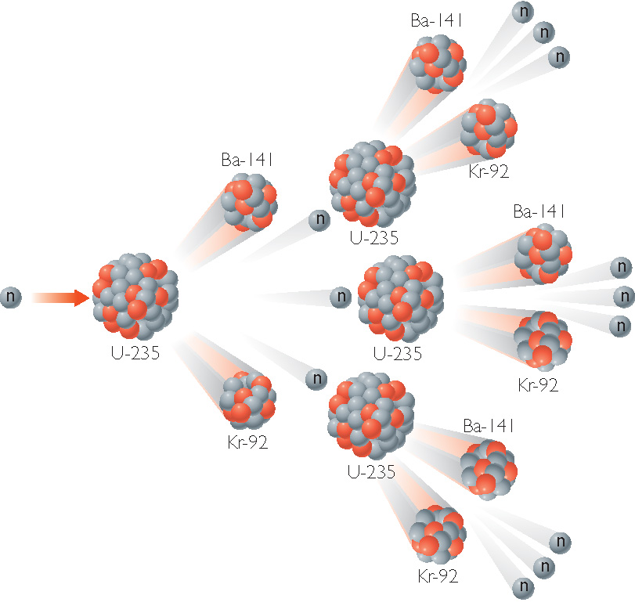
Discussion Notes (cont.)
Nuclear Chain Reactions

Slide 10
Discussion Notes (cont.)
Nuclear fission is a process that releases enormous amounts of energy.
Nuclear fission can result in a nuclear chain reaction that produces a great deal of energy.

Slide 11
Wrap Up
How are new elements formed?
Radioactive decay, nuclear fusion, and nuclear fission are all nuclear processes that result in the creation of new elements.
The mass of a nucleus changes when neutrons or protons are added or lost.
The identity of an element changes when its nucleus gains or loses protons.

Slide 12
Wrap Up (cont.)
Radioactive decay happens in the natural world around us. Fission can be spontaneous for unstable nuclei, or it can be provoked using nuclear bombardment and other methods. Fusion of nuclei to form different isotopes happens in the stars.

Slide 13
Check-In
In a paragraph, defend this statement:
If you want to find gold, your best bet is to dig “old” gold out of the ground. Your chances of making “new” gold are slim.

