Slide 1
Living By Chemistry SECOND EDITION
Unit 1: ALCHEMY
Matter, Atomic Structure, and Bonding

Slide 2
Lesson 15: Nuclear Quest
Nuclear Reactions

Slide 3
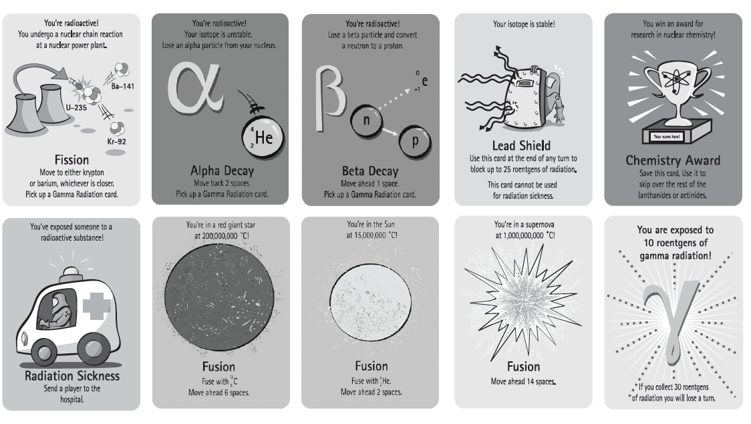
ChemCatalyst
Using the Nuclear Quest game, find the ten kinds of cards shown below. Which cards cause the nucleus of one element to change into the nucleus of a different element?

Slide 4
Key Question
What are nuclear reactions?

Slide 5
You will be able to:
explain the different processes involved in nuclear changes and the conditions required for those processes
explain the connection between nuclear changes and changes in atomic identity

Slide 6
Prepare for the Activity
Work in groups of four.
The goal of the game is to discover element 112 and name it. This is accomplished by moving the nucleus through the entire periodic table.

Slide 7
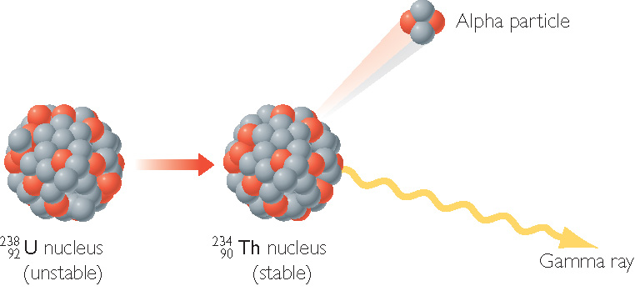
Discussion Notes
Alpha Decay

Slide 8
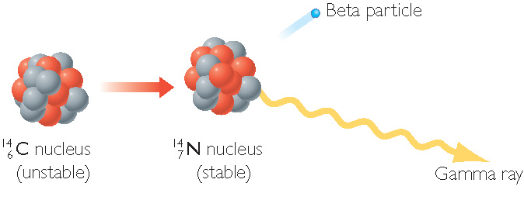
Discussion Notes (cont.)
Beta Decay

Slide 9
Discussion Notes (cont.)
Nuclear chemistry is the study of changes to the nucleus.
Nuclear reaction: A process that involves changes to the nucleus of an atom.
Radioactive decay: A spontaneous process by which an atom emits radiation or a particle from its nucleus to become more stable.
Fusion: The joining of two nuclei to form a larger nucleus accompanied by a release of energy.
Fission: The splitting apart of an atomic nucleus into two smaller nuclei accompanied by a release of energy.

Slide 10
Discussion Notes (cont.)
Changes in the nucleus of an atom can change the identity of an element.
Alpha particle: A particle composed of two protons and two neutrons, equivalent to the nucleus of a helium atom.
Beta particle: An electron emitted from the nucleus of an atom during beta decay.
Gamma ray: A form of high-energy electromagnetic radiation emitted during nuclear reactions.

Slide 11
Discussion Notes (cont.)
Nuclear changes frequently involve the transfer of large amounts of energy.
Alpha decay: A nuclear reaction in which an atom emits an alpha particle. Its atomic number decreases by 2, and its mass number decreases by 4.
Beta decay: A nuclear reaction in which a neutron changes into a proton, and the atom emits a beta particle. The atom’s atomic number increases by 1.

Slide 12
Wrap Up
What are nuclear reactions?
Alpha decay results in a decrease in the atomic number by 2.
Beta decay results in an increase in the atomic number by 1.
Gamma radiation usually accompanies alpha and beta decay and also fission. Gamma radiation can be quite harmful to humans.

Slide 13
Wrap Up (cont.)
Nuclear fission involves a single nucleus breaking apart into two smaller nuclei.
Nuclear fusion involves two nuclei combining to form a nucleus with a larger atomic number. Nuclear fusion takes place in extremely hot environments, such as the cores of stars.

