Slide 1
Living By Chemistry SECOND EDITION
Unit 6: SHOWTIME
Reversible Reactions and Chemical Equilibrium

Slide 2
Lesson 121: How Balanced
Equilibrium Calculations

Slide 3
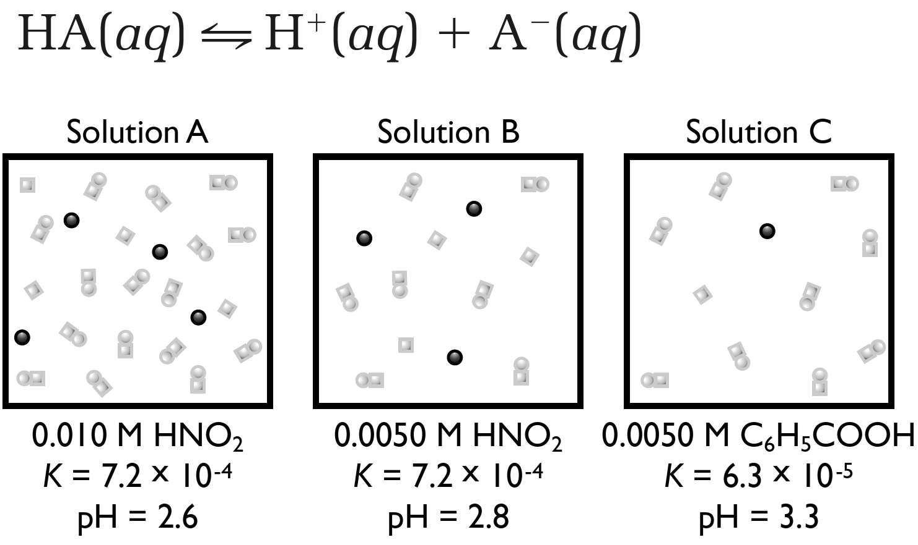
ChemCatalyst
The three squares below show particle views of a tiny volume of three acid solutions.
Solutions A and B contain the same acid at different concentrations. Explain why Solution B has a higher pH than Solution A.
Solutions B and C contain different acids at the same concentration. Why do you think the solutions have different values for the pH in this case?

Slide 4
Key Question
How does K describe the concentrations in an equilibrium mixture?

Slide 5
You will be able to:
solve problems that relate K to the total acid concentration and the solution pH.
understand that K is a property of a speciﬁc process and remains the same for various starting concentrations.

Slide 6
Prepare for the Classwork
Work individually.

Slide 7
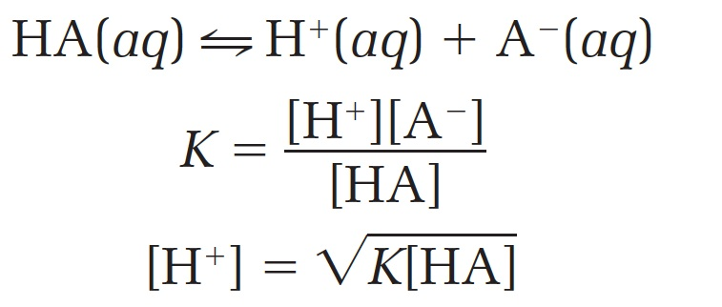
Discussion Notes
The equilibrium constant equation relates the value of K to the concentrations in an equilibrium mixture.

Slide 8
Discussion Notes
The value for [H⁺] at equilibrium is a tiny number.
The value for [HA] at equilibrium is approximately equal to the solution molarity. Because only a tiny amount of HA dissociates, the concentration of HA at equilibrium is just slightly smaller than the solution molarity.
So, it is reasonable to approximate [HA] at equilibrium with the solution molarity.

Slide 9
Discussion Notes (cont.)
The value for [A⁻] at equilibrium is equal to [H⁺] for a weak acid dissolved in pure water. Each time a molecule of HA dissociates, the products are one H⁺ and one A⁻. For a weak acid dissolved in pure water, this means that [H⁺] = [A⁻] .
This is not always true. There are solutions in which the water is not pure but instead contains a salt, such as NaA, thereby adding to the concentration of A⁻.

Slide 10
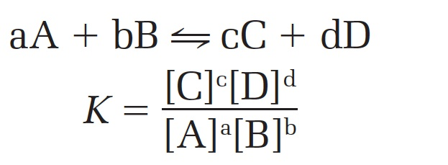
Discussion Notes (cont.)
General form of equilibrium constant equation:
The equilibrium-constant equation varies for different types of processes.

Slide 11
Discussion Notes (cont.)
The square brackets represent concentration
The coefﬁcients in the chemical equation appear in the equilibrium constant equation as exponents.
Pure liquids and solids do not appear in the equation because they do not have a concentration that varies.
K is reported as a dimensionless number, so there are no units.

Slide 12
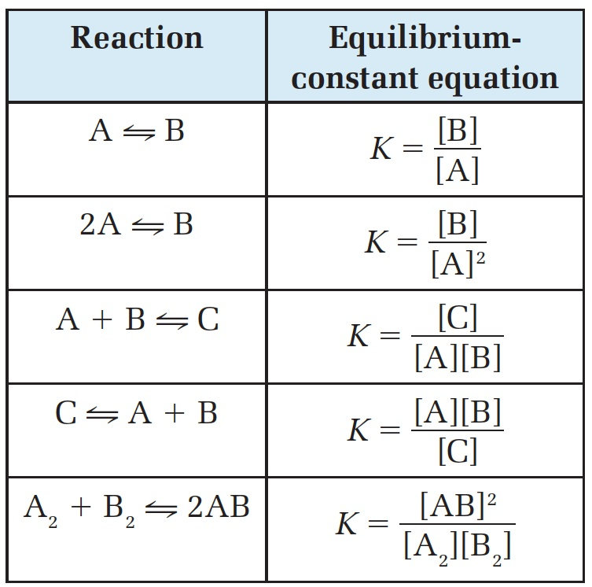
Discussion Notes (cont.)

Slide 13
Wrap Up
How does K describe the concentrations in an equilibrium mixture?
A system at equilibrium reaches a balance between starting substances and products characterized by the equilibrium constant K.
At equilibrium, there is a specific relationship between K and the concentrations of starting substances and products in an equilibrium mixture, called the equilibrium-constant equation.

Slide 14
Check-In
You prepare a solution of 1.0 M HOCl. What is the pH of the solution? (K = 4 x 10⁻⁸)

