Slide 1
Living By Chemistry SECOND EDITION
Unit 1: ALCHEMY
Matter, Atomic Structure, and Bonding

Slide 2
Lesson 12: Atoms By Numbers
Atomic Number and Atomic Mass

Slide 3
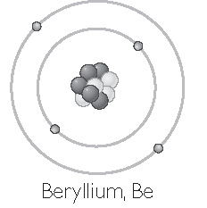
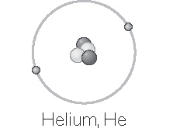
ChemCatalyst
Models of a helium atom and a beryllium atom are shown. The nucleus of each contains protons and neutrons. The electrons orbit the nucleus.
1. Compare the two models. List three similarities and three differences.
Based on the models, why do you think helium is number 2 (the second element) and beryllium number 4 (the fourth element) on the periodic table?

Slide 4
Key Question
How are the atoms of one element different from those of another element?

Slide 5
You will be able to:
distinguish between atomic number, mass of an atom, and average atomic mass
describe the structure of an atom and draw a simple atomic model of an atom
extract information from the periodic table related to atomic structure and atomic mass

Slide 6
Prepare for the Activity
Work in groups.

Slide 7
Discussion Notes
The atomic number of an element is the same as the number of protons in the nucleus of that element.
Atomic number: The number of protons in the nucleus of an atom of an element. In the periodic table, the elements are arranged in order by atomic number.

Slide 8
Discussion Notes (cont.)
Each successive element has one more proton than the element before it.
Protons and neutrons account for most of the mass of an atom.
You can estimate the number of neutrons in an atom by subtracting the number of protons from the average atomic mass of the element (rounded to the nearest whole number).

Slide 9
Discussion Notes (cont.)
The atomic mass of an atom determined by summing the number of protons and neutrons is not identical to the average atomic mass of the element given in the periodic table.
If you change the number of protons in an atom, you also change the elemental identity of that atom.

Slide 10
Wrap Up
How are the atoms of one element different from those of another element?
Each element in the periodic table has one more proton than the element preceding it.
The atomic number of an element is the same as the number of protons in the nucleus of each of its atoms.

Slide 11
Wrap Up (cont.)
In a neutral atom, the number of electrons is equal to the number of protons.
The mass of a proton is 1 atomic mass unit (1 amu). The mass of a neutron is also 1 amu. The mass of an electron is so small it is considered negligible. So the mass of an atom in atomic mass units is simply the sum of the number of protons and the number of neutrons.

Slide 12
Check-In
Use your periodic table to identify these elements.
Atomic number is 18.
Has three electrons when atoms are neutral.
Atomic mass is 16.0.

