Slide 1
Living By Chemistry SECOND EDITION
Unit 6: SHOWTIME
Reversible Reactions and Chemical Equilibrium

Slide 2
Lesson 118: How Backward
Reversible Reactions

Slide 3
ChemCatalyst
If your were to place a sugar cube in your mouth, the sugar would dissolve in your saliva. Some of the molecules of sucrose would attach to speciﬁc taste receptors on your tongue. This produces a signal to the brain of a sweet taste. Eventually, the sweet taste will fade.
Why do you think that the perception of sweetness wears off after a certain span of time?

Slide 4
Key Question
What is a reversible process?

Slide 5
You will be able to:
explain and give examples of reversible processes
define and describe reversible reactions

Slide 6
Discussion Notes
A reversible process is one that proceeds freely in both the forward and the reverse directions. For such processes, it is possible to obtain mainly products or to drive the process in the reverse direction to obtain mainly starting substances.
Reactions that cannot be reversed are said to proceed completely to products. In Unit 5: Fire, you learned about many chemical reactions that go from reactants to products but are not easily reversed.

Slide 7
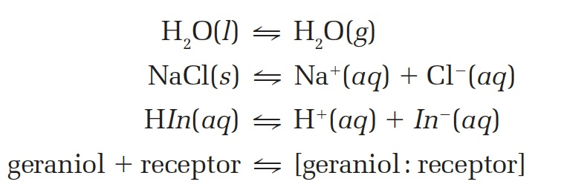
Discussion Notes
Examples of Reversible Processes
What would be observed in each of these processes?
What is the purpose of using a double arrow?
What evidence is there that both starting substances and products are present in these processes?
HOW can you make each of the processes move forward or backward?

Slide 8
Discussion Notes (cont.)
The general process for the binding of a molecule to a receptor site is shown below, where A is a small molecule and B is the receptor. AB indicates that the small molecule is attached to the receptor.

Slide 9
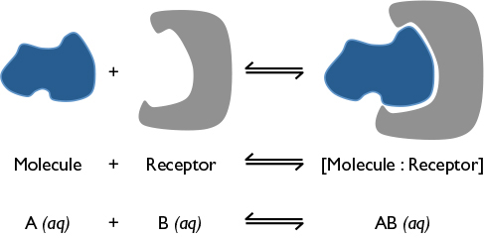
Discussion Notes (cont.)

Slide 10
Discussion Notes
Many processes in the body involve binding of a molecule to a receptor.
The taste receptors on the tongue attract sugar molecules. When a sugar molecule is attached to a taste receptor, this initiates a series of steps that send a signal along nerves to the brain.
Over time, the process reverses, and the molecule leaves the receptor. When this occurs, the sweet sensation stops.

Slide 11
Discussion Notes
Some molecules stay in the receptor longer, thereby creating a stronger sensation (taste). This is because some molecules are attracted more strongly by intermolecular attractions to the receptor.
Artiﬁcial sweeteners are 200 times sweeter than sugar. This is why packets of artiﬁcial sweetener have very little mass.

Slide 12
Wrap Up
What is a reversible process?
A reversible process is one that can proceed freely in both the forward and the reverse directions.
A double arrow is used to indicate a reversible reaction.
Many physical and chemical changes are reversible given appropriate conditions such as
Physical: phase changes, dissolving/precipitation Chemical: acid-base reactions, binding to protein receptors.

Slide 13
Check-In
Consider the reversible process for the binding of a smell molecule:
What will happen to the perception of a minty smell if you inhale after opening a bottle containing menthol?
What will happen to the perception of a minty smell if you exhale?

