Slide 1
Living By Chemistry SECOND EDITION
Unit 5: FIRE
Energy, Thermodynamics, and Oxidation-Reduction

Slide 2
Lesson 115: Beyond What You See
Electromagnetic Radiation

Slide 3
ChemCatalyst
Each situation described below involves light.
Both the sun and an ordinary indoor lamp emit light. When you are outside in the Sun, you can get a sunburn. But when you are inside in a room lit by an ordinary lamp, you will not get a sunburn. Propose a hypothesis to explain how this is possible.
Bees detect different colors on the petals of a ﬂower. A human looking at the same ﬂower sees the petals as being one uniform color. Propose a hypothesis to explain how this occurs.

Slide 4
Key Question
What is the evidence for light waves that are invisible to your eyes?

Slide 5
You will be able to:
describe electromagnetic radiation.
relate wavelength and frequency of light waves to energy transfer.

Slide 6
Prepare for the Classwork
Work in groups of 4.

Slide 7
Discussion Notes
The light that we see is a tiny part of a large collection of waves called electromagnetic radiation.
Electromagnetic radiation exists with a huge range of wavelengths and frequencies. The various wavelength regions are classiﬁed with names such as gamma rays, x-rays, ultraviolet rays, visible light, infrared rays, microwaves, and radio waves.

Slide 8
Discussion Notes
Notice that both the words ray and wave are used. These words are consistent with the two models we have discussed, the ray model and the wave model.
Electromagnetic radiation

Slide 9
Discussion Notes
Only waves that travel at the speed of light are classiﬁed as electromagnetic radiation.
We see only a narrow band of electromagnetic radiation as visible light. However, the eyes of owls and butterﬂies allow them to detect ultraviolet light. Sunburn is evidence that the Sun emits more than just visible light.

Slide 10
Discussion Notes (cont.)
It possible to build instruments that detect wave-lengths of electromagnetic radiation that are outside the visible range. There are devices similar to digital cameras that can detect infrared light. These devices detect the infrared light and generate an image of what is invisible to our eyes. These images greatly expand our under-standing of the world.

Slide 11
Discussion Notes (cont.)
Electromagnetic radiation transfers energy when it interacts with matter.
One way that energy is transferred is by direct contact between two objects at different temperatures.
Energy is transferred by conduction until the two objects are at the same temperature.
Energy is also transferred when light interacts with matter. This is referred to as transfer of energy by radiation.

Slide 12
Discussion Notes (cont.)
Planck’s constant relates the frequency of the electromagnetic wave to its energy. Planck’s constant is given the symbol h,
where h = 6.63 x 10⁻³⁴ J •s.
The formula shows the relationship between energy, frequency and wavelength of light.
E = hf = hc
λ

Slide 13
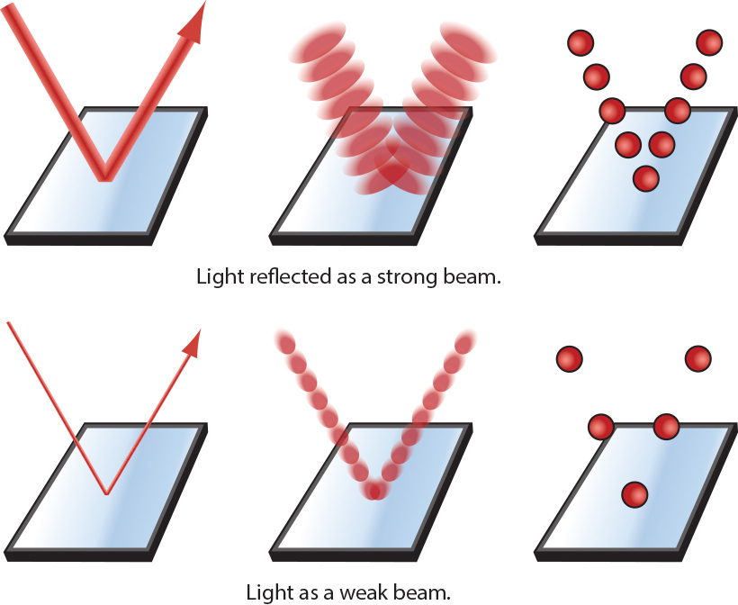
Discussion Notes (cont.)
A photon model is a third model to describe light. It is useful to think about one up-and-down motion of the wave as a “particle” or photon of light.

Slide 14
Discussion Notes (cont.)
Photons associated with waves of higher frequency transfer a greater amount of energy per photon. If the light of a speciﬁc frequency is brighter, there is a greater number of photons.

Slide 15
Wrap Up
What is the evidence for light waves that are invisible to your eyes?
The light that we see is a tiny part of a large collection of waves called electromagnetic radiation.
Electromagnetic radiation exists with a huge range of wavelengths and frequencies. The wavelength regions include radio waves, microwave radiation, infrared radiation, visible light, ultraviolet radiation, x-rays, and gamma rays.

Slide 16
Wrap Up
The entire collection of waves travels at the same speed, the speed of light, c = 3 x 10⁸ m/s. The energy transferred by electromagnetic radiation is proportional to the frequency of the wave.
Electromagnetic waves of high frequency transfer more energy than waves of low frequency.
High-frequency electromagnetic waves such as gamma rays and x-rays are quite dangerous because of the large amount of energy they transfer, even with a dim beam.

Slide 17
Check-In
Imagine two beams of electromagnetic radiation. The wavelength of one beam is 10⁻⁸ m. The wavelength of the second beam is 10⁻² m.
Use the information on the worksheet to classify these two waves.
Which wave transfers more energy? Explain your thinking.

