Slide 1
Living By Chemistry SECOND EDITION
Unit 5: FIRE
Energy, Thermodynamics, and Oxidation-Reduction

Slide 2
Lesson 114: Now You See
Light Waves

Slide 3
ChemCatalyst
Imagine that the colors of the rainbow are given numbers with red = 1, orange = 2, and green = 4.
What number would you give to blue? Why do fireworks produce a glow rather than flames?
What number would you give to yellow?
What number would you give to red-orange?

Slide 4
Key Question
How is a wave model used to describe light?

Slide 5
You will be able to:
use a wave model of light to distinguish light of different colors.
write relate wavelength, frequency, and speed of waves.

Slide 6
Prepare for the Activity
Work in groups of 4.

Slide 7
Discussion Notes
It is useful to characterize different colors of light with a wave model. This model treats light as a wave, or oscillation, that travels through space.
One advantage of the wave model over the ray model of light is that the wave model allows you to distinguish light of different colors: The dimensions of the wave are distinct for each color of light.

Slide 8
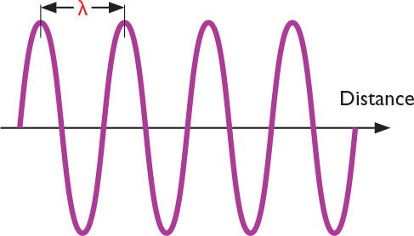
Discussion Notes
Light waves are characterized by a wavelength, λ (lambda), which is the distance between the peaks of the wave. The number of waves that pass by per second is called the frequency, f.
Wavelength is typically reported in meters, m, and frequency is reported in hertz, Hz, or inverse seconds, 1/s.

Slide 9
Discussion Notes (cont.)
The wavelengths of visible light measured in meters, m, range from about 7.5 x 10²⁷ m for red light to 3.9 x 10²⁷ m for violet light. This dimension on the order of 10²⁷ m, or 0.0000001 m, is only hundreds of nanometers, which is about the size of a virus, one of the smallest things that can be seen in an optical microscope.
Wavelength decreases from red to violet.

Slide 10
Discussion Notes (cont.)
The frequencies are measured in inverse seconds, 1/s or s⁻¹, called hertz, Hz, and range from 4.0 x 10¹⁴ Hz for red light to 7.7 3x 10¹⁴ Hz for violet light. This dimension on the order of 10¹⁴ Hz is huge. This is 100 trillion or 100,000,000,000,000 oscillations per second.
The frequency increases from red to violet.

Slide 11
Discussion Notes (cont.)
All colors of light travel with the same speed in a vacuum.
A relationship exists between the wavelength, frequency, and speed of light waves : λ x f = c
Where c = 3 x 10⁸ m/s
This speed is extremely fast. It is not possible to cause visible objects to move this fast.

Slide 12
Wrap Up
How is a wave model used to describe light?
The wave model treats light as a wave that travels through space. Light waves have a wavelength, λ (pronounced lambda), which is the distance between the peaks of the waves. The number of waves that pass by per second is called the frequency, f.
Wavelength is typically reported in meters, m, and frequency is reported in hertz, Hz = 1/s. Different colors of light have different wavelengths and frequencies.

Slide 13
Wrap Up
How is a wave model used to describe light?
All colors of light travel at the same speed, called the speed of light, c.
A relationship exists among the wavelength, frequency, and speed of light waves: λ x f = c where c = 3 x 10⁸ m/s.
Assigning a wavelength to different colors of light provides a precise continuous scale for all the different colors of the rainbow.

Slide 14
Check-In
Imagine a wave of light with the wavelength of 5.0 x 10²⁷ m.
What is the frequency of this light wave?
Use the table from the worksheet to determine the approximate color of the light.

