Slide 1
Living By Chemistry SECOND EDITION
Unit 5: FIRE
Energy, Thermodynamics, and Oxidation-Reduction

Slide 2
Lesson 113: All Aglow
Light Energy

Slide 3
ChemCatalyst
How does light travel to your eye? Draw a picture that shows the path of light from a light bulb to a book on a table and then to your eye

Slide 4
Key Question
How can you describe light shining on matter?

Slide 5
You will be able to:
use light rays to indicate the path light travels from a source to an object to your eye.
describe emission, reﬂection, transmission, and absorption of light.

Slide 6
Prepare for the Activity
Work in Groups of 4

Slide 7
Discussion Notes
Light is emitted from a light source, such as the Sun or an electric light bulb. Nuclear reactions on the Sun transfer an enormous amount of energy to raise the temperature of the Sun to nearly 6000 K. The thermal energy is transferred through space to Earth as light.
Other hot objects transfer energy as light, such as the thin piece of tungsten wire in a light bulb.

Slide 8
Discussion Notes (cont.)
It is not possible to see light as it travels through space. It is only possible to detect light when it strikes an object.
The path of light is commonly called a light ray. It is typical to use straight lines to indicate the path of the light.

Slide 9
Discussion Notes (cont.)
White light is a mixture of colors. When white light passes through a prism or a water droplet in the sky, the white light spreads out into a rainbow of colors. The colors are always in the same sequence: red, orange, yellow, green, blue, and violet.

Slide 10
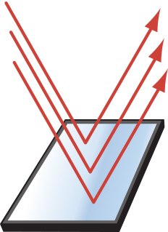
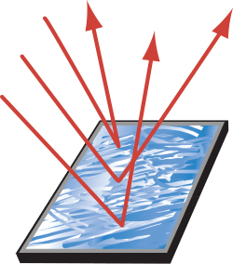
Discussion Notes (cont.)
Most objects reﬂect some light. When light shines on an object, some or all of the light is reﬂected.
When light reﬂects from a smooth surface, all the light rays are parallel to one another.
When light reﬂects from a rough surface, the light rays go off in many different directions

Slide 11
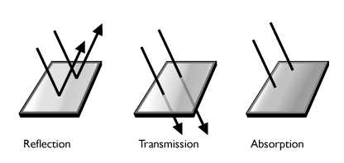
Discussion Notes (cont.)
Some objects transmit light. Light passes through certain types of objects such as glass, thin fabric, and thin sheets of plastic.

Slide 12
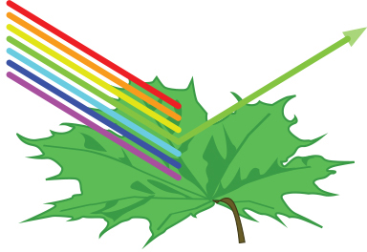
Discussion Notes (cont.)
Colored objects partially absorb light.
When white light shines on an object that appears green, it is because green light is reflected and the other colors are absorbed.

Slide 13
Wrap Up
How can you describe light shining on matter?
Light is a form of energy emitted from sources such as the Sun and light bulbs. The light travels through space undetected until it strikes an object.
The object can reflect, transmit, or absorb the light. Your eye detects reflected and transmitted light that travels toward you.
A colored object reflects or transmits the color or colors you perceive, while it absorbs the other colors. Black objects absorb all colors.

Slide 14
Check-In
Consider a pair of sunglasses that are tinted green.
Draw a picture to show what happens when sunlight shines on the sunglasses.
What color of light is transmitted?
What color of light is absorbed?

