Slide 1
Living By Chemistry SECOND EDITION
Unit 5: FIRE
Energy, Thermodynamics, and Oxidation-Reduction

Slide 2
Lesson 112: Current Events
Electrochemical Cell

Slide 3
ChemCatalyst
Activity Series
Oxidation half reactions
sodium | Na➔Na⁺ + e–
magnesium | Mg ➔Mg²⁺ + 2e–
aluminum | Al ➔ Al³⁺ + 3e–
zinc | Zn ➔ Zn²⁺ + 2e–
iron | Fe ➔ Fe²⁺ + 2e–
lead | Pb ➔ Pb²⁺ + 2e–
copper | Cu ➔ Cu²⁺ + 2e–
silver | Ag ➔ Ag⁺ + e–
gold | Au ➔ Au⁺ + e–
The table shows the oxidation half of some oxidation-reduction reactions. Suppose you want to set up an oxidation-reduction reaction. Which pairing of metal and metal ion do you think will result in the greatest energy release?
Explain your reasoning.

Slide 4
Key Question
How can you use a redox reaction as an energy source?

Slide 5
You will be able to:
describe an electrochemical cell and how it works
write half reactions for possible electrochemical half cells
use an activity series to help design electrochemical cells

Slide 6
Prepare for the Lab
Work in groups of four.
Wear safety goggles at all times.
Use surgical gloves when handling the salt bridge.

Slide 7
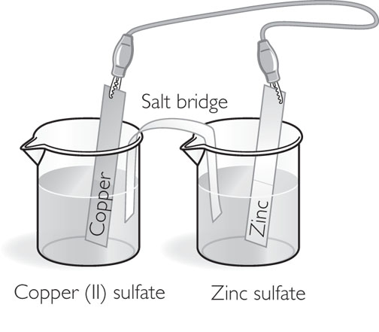
Discussion Notes
Whenever there is chemical change, there is also some sort of energy transfer.
An electrochemical cell creates electrical energy from chemical energy.

Slide 8
Discussion Notes (cont.)
Different pairs of metals will produce different amounts of energy.
Activity Series | Oxidation half reactions
sodium | Na➔Na⁺ + e–
magnesium | Mg ➔Mg²⁺ + 2e–
aluminum | Al ➔ Al³⁺ + 3e–
zinc | Zn ➔ Zn²⁺ + 2e–
iron | Fe ➔ Fe²⁺ + 2e–
lead | Pb ➔ Pb²⁺ + 2e–
copper | Cu ➔ Cu²⁺ + 2e–
silver | Ag ➔ Ag⁺ + e–
gold | Au ➔ Au⁺ + e–
Fe and Pb²⁺ Small energy release
Mg and Ag⁺ Large energy release

Slide 9
Discussion Notes (cont.)
Electrochemical cells are used in batteries.
The potential energy of an electrochemical cell is expressed in volts.
Standard Reduction Potentials at 25°C, 1 atm, and 1 M Ion Concentration
Reduction Reaction | Half-Cell Potential
Li⁺ + e– ➔ Li | –3.05 volts
Mg²⁺ + 2e– ➔ Mg | –2.37 volts
Zn²⁺ + 2e– ➔ Zn | –0.76 volt
Cu²⁺ + 2e– ➔ Cu | 0.34 volt
Ag⁺ + e– ➔ Ag | 0.80 volt

Slide 10
Discussion Notes (cont.)
When an electrochemical cell is generating electricity, the total overall voltage can be calculated by finding the difference between the potentials of the two half reactions.

Slide 11
Wrap Up
How can you use a redox reaction as an energy source?
An electrochemical cell converts chemical energy to electrical energy.
The farther apart two metals are on the activity series, the more energy will be released when they participate in a redox reaction.

Slide 12
Wrap Up (cont.)
The electrons generated in an electrochemical cell move through the external circuit from the metal that is being oxidized (the more active metal) to the electrode where reduction is occurring.
The voltage of an electrochemical cell is a measure of that cell’s potential to produce electrical energy.

Slide 13
Check-In
Draw an electrochemical cell that uses magnesium and copper. Label the parts.
What is being oxidized? What is being reduced? Label each beaker with its half reaction.

