Slide 1
Living By Chemistry SECOND EDITION
Unit 5: FIRE
Energy, Thermodynamics, and Oxidation-Reduction

Slide 2
Lesson 108: Metal Magic
Oxidation

Slide 3
ChemCatalyst
Fireworks contain small metal particles that react with oxygen. For example, when copper, Cu, reacts with oxygen there is a green glow.
2Cu(s) + O₂(g) ➔ 2CuO(s)
Explain why copper powder reacts vigorously with oxygen, while a copper saucepan does not.
Why do fireworks produce a glow rather than flames?
If copper powder reacted with oxygen in a sealed container, would the container be in danger of exploding? Explain your reasoning.

Slide 4
Key Question
What happens when metals react with oxygen?

Slide 5
You will be able to:
define and generally explain oxidation
write chemical equations for the oxidation of metals

Slide 6
Prepare for the Demonstration
Work as a whole class.

Slide 7
Discussion Notes
Under the right conditions, metals react with oxygen.
Flames typically are not observed when metals combust.
Two variables in particular have the greatest effect on the rate of the reaction of metals with oxygen.

Slide 8
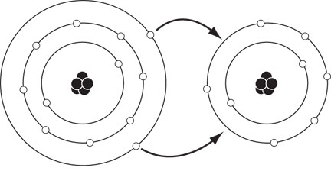
Discussion Notes (cont.)
Electrons transferred during formation of magnesium oxide, MgO.
The reaction of metals with oxygen is called oxidation.
Oxidation: The reaction of a substance with oxygen. Also, the loss of electrons by an atom or ion during a reaction.

Slide 9
Discussion Notes (cont.)
Metals are especially susceptible to oxidation because they have one, two, or three electrons in their outermost (valence) electron shell.
All combustion reactions are oxidation reactions.

Slide 10
Wrap Up
What happens when metals react with oxygen?
Metal atoms react with oxygen to form metal oxides. When these metal oxides are formed, heat is released and oxygen is consumed.
Flames are not present when metals oxidize, but bright light may be observed.
Oxidation is defined as the chemical combination of a substance with oxygen. It is more broadly defined as the transfer of electrons by a molecule, atom, or ion.

Slide 11
Check-In
Write the chemical equation for the oxidation of zinc. Make sure it is balanced.

