Slide 1
Living By Chemistry SECOND EDITION
Unit 5: FIRE
Energy, Thermodynamics, and Oxidation-Reduction

Slide 2
Lesson 106: Speed Things Up
Rate of Reaction

Slide 3
ChemCatalyst
Paper and a log are made from the same compounds. Why don’t they burn at the same speed?

Slide 4
Key Question
How can you control the speed of a reaction?

Slide 5
You will be able to:
describe the conditions that speed up reactions
explain how a catalyst works

Slide 6
Prepare for the Demonstration
Work as a whole class.
Wear safety goggles during the demonstration.

Slide 7
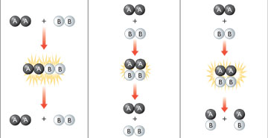
Discussion Notes
Enough energy but incorrect orientation:
Correct orientation but not enough energy:
Enough energy and correct orientation:
For a reaction to occur, the reactants must collide with one another with enough energy and in the correct orientation to break bonds in the reactants and form new bonds.
No products form.
No products form.
Products form.

Slide 8
Discussion Notes (cont.)
A variety of factors affect the rate at which a reaction will proceed.
Surface area
Mixing
Temperature
Concentration or pressure
Energy

Slide 9
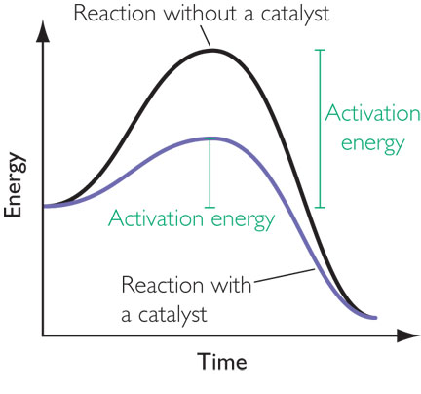
Discussion Notes (cont.)
A catalyst is a substance that is added to a reaction mixture to speed up the reaction.
Catalysts work in two main ways.

Slide 10
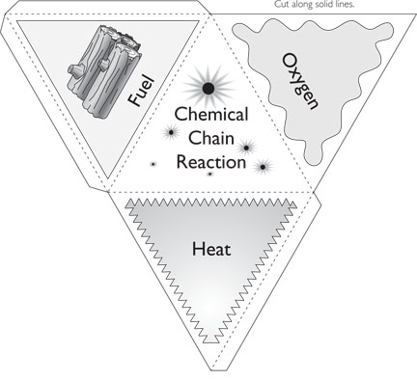
Discussion Notes (cont.)
A spark or other input of energy is needed to start a fire.
The fire tetrahedron represents the four factors necessary for fire to occur.

Slide 11
Wrap Up
How can you control the speed of a reaction?
The rate of a reaction can be increased by increasing the probability of collisions between the molecules of the reactants.
Some ways to increase the rate of a reaction are to increase the surface areas of the reactants, to increase the concentration of the reactants, to conduct the reaction at a higher temperature, to mix the reactants, and to use a catalyst.
If the activation energy of a reaction can be lowered, the rate of the chemical reaction will increase. Catalysts lower the activation energy.

Slide 12
Check-In
You want to burn a piece of binder paper. Name three things you can do to increase the rate of combustion of the paper.

