Slide 1
Living By Chemistry SECOND EDITION
Unit 5: FIRE
Energy, Thermodynamics, and Oxidation-Reduction

Slide 2
Lesson 105: Over the Hill
Reversing Reactions

Slide 3
ChemCatalyst
Hydrogen is considered the clean fuel of the future for automobiles. The simple chemistry behind the technology is the combustion of hydrogen to produce water and 286 kJ of heat (per mole of hydrogen used).
Write the chemical equation for this reaction. Balance it.
What is the net energy input or output of the reaction as written?
What kind of energy exchange would you expect if you completed the reverse reaction and formed hydrogen and oxygen from water? Explain your thinking.

Slide 4
Key Question
What is the energy associated with reversing reactions?

Slide 5
You will be able to:
use energy diagrams to compare forward and reverse reactions
explain changes in kinetic and potential energy in chemical reactions
define activation energy

Slide 6
Prepare for the Classwork
Work individually.

Slide 7
Discussion Notes
The energy diagrams for a reaction and its reverse reaction are mirror images of each other because energy is conserved.
Nitrogen dioxide

Slide 8
Discussion Notes (cont.)
Combustion of methane

Slide 9
Discussion Notes (cont.)
Combustion of hydrogen

Slide 10
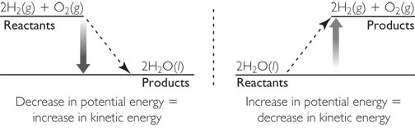
Discussion Notes (cont.)
At any point in time, all the energy in a system can be considered either kinetic energy (energy of heat and motion) or potential energy (energy of position or composition).

Slide 11
Discussion Notes (cont.)
When the potential energy changes, the kinetic energy also changes because energy is conserved.
Every chemical reaction (not just combustion reactions) requires some sort of energy input to start it.
Activation energy: The minimum amount of energy required to initiate a chemical process or reaction.

Slide 12
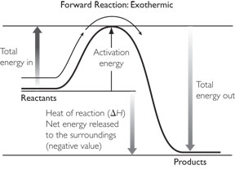
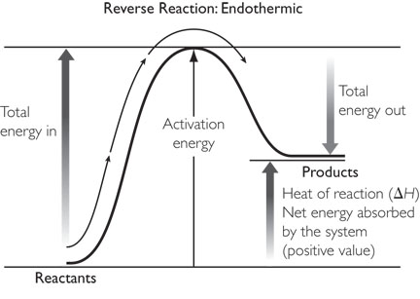
Discussion Notes (cont.)
The activation energy of a reaction depends on factors other than the value of the heat of reaction, H∆.

Slide 13
Wrap Up
What is the energy associated with reversing reactions?
The energy diagram of a reaction and the reverse reaction are mirror images of each other.
The energy in a chemical system is in the form of either kinetic energy or potential energy.
When substances combust, a great deal of potential energy is converted to kinetic energy. The potential energy of the system decreases.
The energy required to start a reaction is called the activation energy.

Slide 14
Check-In
Draw an energy diagram for a reaction that releases heat. Label the energy involved in the reaction.
Explain how your diagram shows that energy is conserved.

