Slide 1
Living By Chemistry SECOND EDITION
Unit 5: FIRE
Energy, Thermodynamics, and Oxidation-Reduction

Slide 2
Lesson 104: Make It or Break It
Bond Energy

Slide 3
ChemCatalyst
When a fuel is burned, energy is released. Where do you think that energy comes from?
Consider this reaction:
CH₄(g) + 2O₂(g) ➔ CO₂(g) + 2H₂O(g)
What is happening to the methane molecules as they combust?

Slide 4
Key Question
Where does the energy from an exothermic reaction come from?

Slide 5
You will be able to:
calculate the net energy exchange due to a chemical reaction
draw and interpret energy exchange diagrams
explain the source of heat in a combustion reaction

Slide 6
Prepare for the Activity
Work in pairs.

Slide 7
Discussion Notes
It takes energy to break bonds between atoms.
Making bonds between atoms releases energy.

Slide 8
Discussion Notes (cont.)
This table shows the average bond energies of
some common bonds.
Bond energy: The amount of energy required to
break a specific chemical bond.
Average Bond Energies (per mole of bonds)
Bond | H–H | C–H | C–C | C=C | O–H | C–O | C=O | O=O | O–O
Bond energy (kJ/mol) | 432 | 413 | 347 | 614 | 467 | 358 | 799* | 495 | 146
*C=O in CO2: 799; C=O in organic molecules: 745.

Slide 9
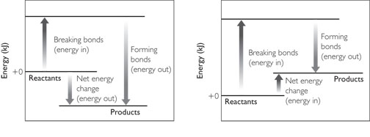
Discussion Notes (cont.)
The net energy exchange of a reaction is the difference between the energies of the bond-breaking and bond-making processes.

Slide 10
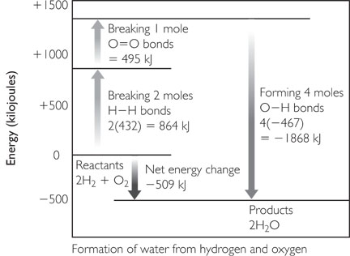
Discussion Notes (cont.)
Each chemical reaction has a net energy exchange, which determines whether a reaction is exothermic or endothermic.
An energy exchange diagram is a helpful way to get an overall picture of the energy changes that occur during a chemical reaction.

Slide 11
Discussion Notes (cont.)
For an exothermic reaction, the total energy out is greater than the total energy in.
For an endothermic reaction, the total energy in is greater than the total energy out.
Energy exchange for an exothermic reaction.
Energy exchange for an endothermic reaction.

Slide 12
Wrap Up
Where does the energy from an exothermic reaction come from?
Breaking bonds requires energy. Making bonds releases energy.
Average bond energy values can be used to calculate the net energy exchanged during a chemical reaction.
The net energy of a reaction is the difference between the energy required to break bonds and the energy released in forming bonds.
Exothermic reactions have a net energy output. Endothermic reactions have a net energy input.

Slide 13
Check-In
How do you think the energy exchange diagram for the combustion of ethane would differ from the diagram for methane?

