Slide 1
Living By Chemistry SECOND EDITION
Unit 5: FIRE
Energy, Thermodynamics, and Oxidation-Reduction

Slide 2
Lesson 103: Fuelish Choices
Heat of Combustion

Slide 3
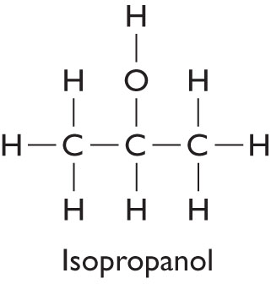
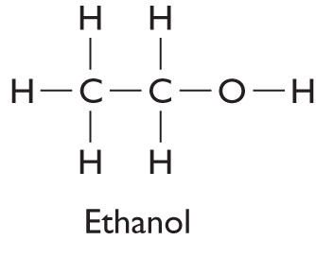
ChemCatalyst
An engineer wants to know which of these two alcohols is a better rocket fuel.
What do you think “better” means in this case?
What measurements would you need to make to determine the better choice?

Slide 4
Key Question
How do different fuels compare to one another?

Slide 5
You will be able to:
define heat of reaction and heat of combustion
perform a calorimetry procedure to determine the heat of combustion of two different alcohols
compare the heats of combustion of different carbon-based fuels

Slide 6
Prepare for the Lab
Work in groups of four.

Slide 7
Prepare for the Lab (cont.)
Wear safety goggles at all times.

Slide 8
Discussion Notes
Heat of Combustion of Common Fuels
Fuel | Chemical formula | ∆H (kJ/mol) | ∆H (kJ/g)
carbon (coal) | C(s) | –393 | –32.6
methane | CH₄(g) | –891 | –55.6
ethane | C₂H₆(g) | –1560 | –51.9
butane | C₄H₁₀(l) | –2882 | –49.6
hexane | C₆H₁₄(l) | –4163 | –48.1
isopropanol | C₃H₈O(l) | –2008 | –33.5
octane | C₈H₁₈(l) | –5508 | –47.7
methanol | CH₄O(l) | –724 | –22.6
ethanol | C₂H₆O(l) | –1368 | –29.7
butanol | C₄H₁₀O(l) | –2669 | –36.0
glucose | C₆H₁₀O₆(s) | –2828 | –15.9
hydrogen | H₂(g) | –243 | –121.3

Slide 9
Discussion Notes (cont.)
The amount of energy transferred during any reaction is referred to as the heat of reaction. The energy transferred during burning is called the heat of combustion.
Heat of reaction, ∆H: The amount of heat transferred during a chemical reaction.
Heat of combustion, ∆H: The amount of heat transferred when a compound undergoes complete combustion with oxygen.

Slide 10
Discussion Notes (cont.)
Chemists use something called a bomb calorimeter to measure the amount of heat released by fuels.
Hydrocarbons make good fuels.
The energy output from combustion of each substance is just one consideration in rating fuels.

Slide 11
Discussion Notes (cont.)
Scientists use joules as a unit of energy.
Joule: The metric unit of energy commonly used by scientists. One calorie is equal to 4.184 joules.
1 joule ~ 0.239 calorie
1 calorie ~ 4.184 joules

Slide 12
Wrap Up
How do different fuels compare to one another?
The amount of energy transferred when a fuel is burned is called the heat of combustion.
Substances consisting mostly of carbon and hydrogen atoms are good fuels.
Trends show that the larger the carbon compound, the more energy released per mole of fuel when that compound combusts.
The metric unit for energy is the joule: 1 calorie equals 4.184 joules.

Slide 13
Check-In
Which fuel provides more energy per mole, paraffin or propane?
How much energy would you expect to be released by burning 1 g of each of these substances?
Which substance is a better fuel by weight?

